Slide 1
Africa Regional Workshop on Strengthening TB Monitoring and Evaluation Systems
16-19 April, 2024 • Dar es Salaam, Tanzania
NTP UPDATES: South Africa

Slide 2
Country TB Profile and TB Situation Snapshot

Slide 3
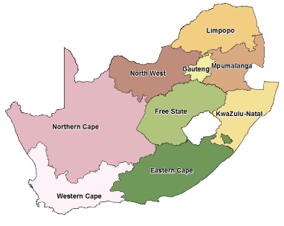
South Africa’s Demographic Profile
South African population ➙ 62,027,503 (2022 Census Data);
The population steadily increased between 1996 & 2022, from 40 million to 62 million;
Female to male percentage ➙ 51.5 to 48.5 – varying within provinces;
Racially diverse ➙ African (81.4%); coloured (8.2%); white (7.3); Indian (2.7%);
Median Age ~ 28 years (2022) from 22 years in 1996 ⇡ of 6 years;
Migration patterns indicate more in-migration than outmigration in 2 provinces – Gauteng (mostly mining & industrial opportunities) & Western Cape (commercial farming);

Slide 4
TB Snapshot and Situation in South Africa
South Africa is among the 30 high TB burden countries contributing 87% of the global TB cases in 2022.
2022 estimated TB incidence: 280K and a rate of 468/100k population
TB/HIV incidence rate: 255/100k population
MDR-/RR-TB incidence rate: 19/100K population; incidence males vs females = 163k vs 117k respectively
2022 total notifications: 224,621, of which new & relapse is 214,295 TB cases – 358/100k population;
Mortality rate among HIV⁺ = 52/100k
Universal healthcare coverage: 77%
Catastrophic costs: 56%
TB case fatality rate: 20%
Known HIV⁺ status: 54%
ART coverage: 88%
Treatment success rate (new & relapse): 79%
Previously treated (excl. relapse): 60%
Treatment success rate (MDR-/RR-TB): 62%
% HIV⁺ started on ART on TPT: 62%

Slide 5
Data-Driven Strategies: Update on national TB M&E, surveillance, and data use

Slide 6
Strategies for Using National TB Data
Contained in TB Recovery Plan; the TB Strategic Plan; Annual Performance Plan & the National HIV and TB Strategic Plan.
South Africa aligns with the End TB Strategy 2035 as part of the Sustainable Development Goals.
Concerted efforts reflected in the National Development Plan (NDP) 2030 – specific to South Africa. TB features as one of the conditions aimed at increasing life expectancy through various efforts to eliminate.
Development of specific entities to focus on TB specific issues – like the TB Think Tank.
Routine reporting systems guided by the District Health Management Information System (DHMIS) Policy.

Slide 7
Improvements and Changes to the National TB M&E System
Development of electronic surveillance systems (e.g. electronic medical record [EMR]); targets and updating of health systems.
Research activities undertaken to provide invaluable information for decision-making.
Implementation of DHMIS Policy nationally, monitored by the Research, Information, Monitoring, Evaluation & Surveillance (RIMES) unit on the side of TB.
Biennial updating of National Indicator Dataset (NIDS), Provincial Indicator Datasets (PIDS) to reflect national and international changes in TB outlook – a data-driven process

Slide 8
Successful Data-Driven Initiatives
Implementation of WHO recommended rapid diagnostics.
Synergy between laboratory and programme data sharing initiative.
Turn around times of diagnostic results based on data reports.
B-PaL rollout for DR-TB patients – a short term regimen initiative that is proving effective.
Successful monitoring of adverse events on treatment.

Slide 9
Common Challenges in Data Quality
Incomplete data – gaps or missing information.
Delays in capturing of data on surveillance systems.
Incorrect development of indicator algorithms in the Three Interlinked Electronic Registers (TIER.Net), resulting in misclassifications and misinformation.
Electricity load-shedding resulting in the corruption of information during electricity outages.
Limited number of computers in some basic management units (BMUs).
Lack of supervision in some areas resulting in erratic data management processes.
The nature of the surveillance system (desktop based) is limiting as data flow patterns fall short of providing timeous and well processed data.

Slide 10
Vision for Future of Data-Driven TB Control & Upcoming Plans
Implementation of EMR as a surveillance system;
Use of a unique identifier and live or real-time electronic surveillance system;
Implementation of tested community-based monitoring systems.
National Health Insurance and complementing data initiatives that include one-patient one-record.
National implementation of the Electronic Medical Record (EMR) and a single database for South African citizens.

Slide 11
TB M&E Beyond Numbers: Understanding trends in PBMEF core indicators

Slide 12
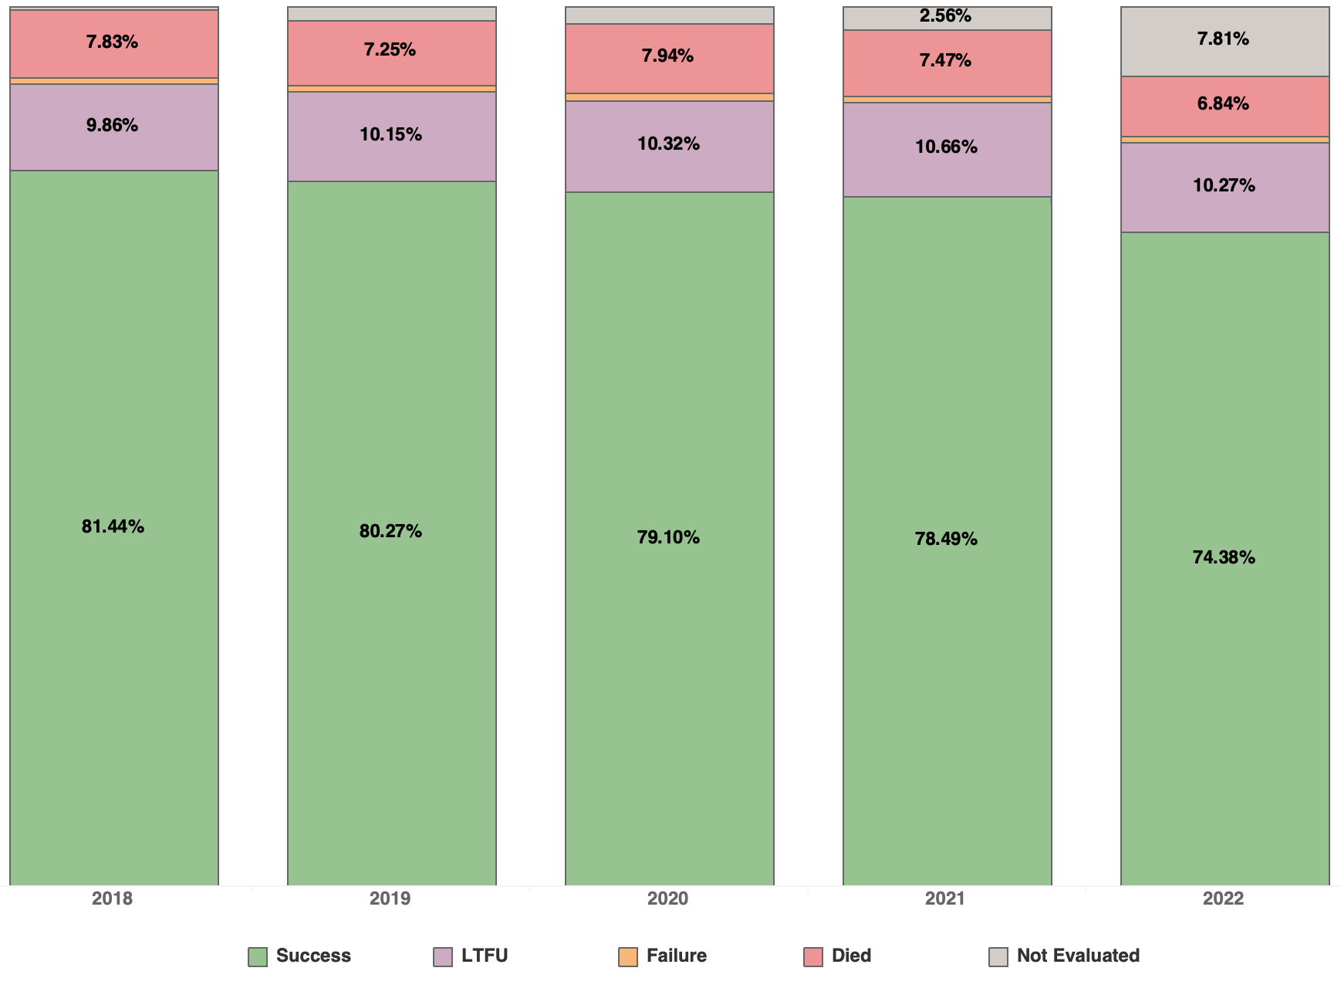
Indicator: DS-TB Treatment Success Rates (2018 – 2022)
Other outcomes are displayed to show the relationship to treatment success.
Challenges have been met with surveillance systems.
All DS-TB treatment success has not changed over years – remaining stable around 80%.
The high LTFU & NE cases affect Treatment Success negatively.
2022 cases not fully reported as yet – hence a lower treatment success rate

Slide 13
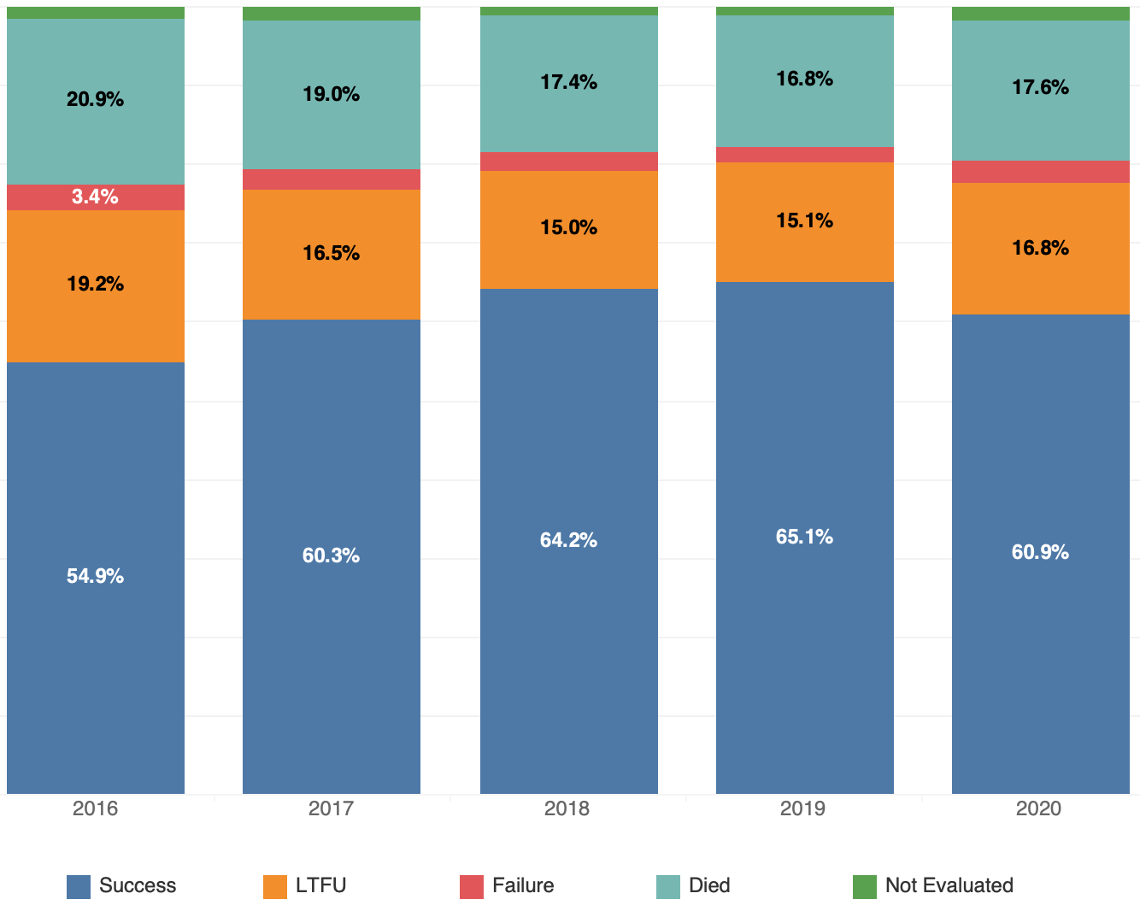
Indicator: DR-TB Treatment Success Rate (2016 – 2020)
Disaggregated DR-TB according to RR/MDR-TB and PreXDR/XDR-TB provide different Treatment outcomes – with RR/MDR-TB showing better outcomes compared to PreXDR and XDR-TB.
Here all DR-TB are aggregated to show varying treatment success rate.

