Slide 1
Digital products to support TB surveillance and programme planning
Marek Lalli

Slide 2
Background

Slide 3
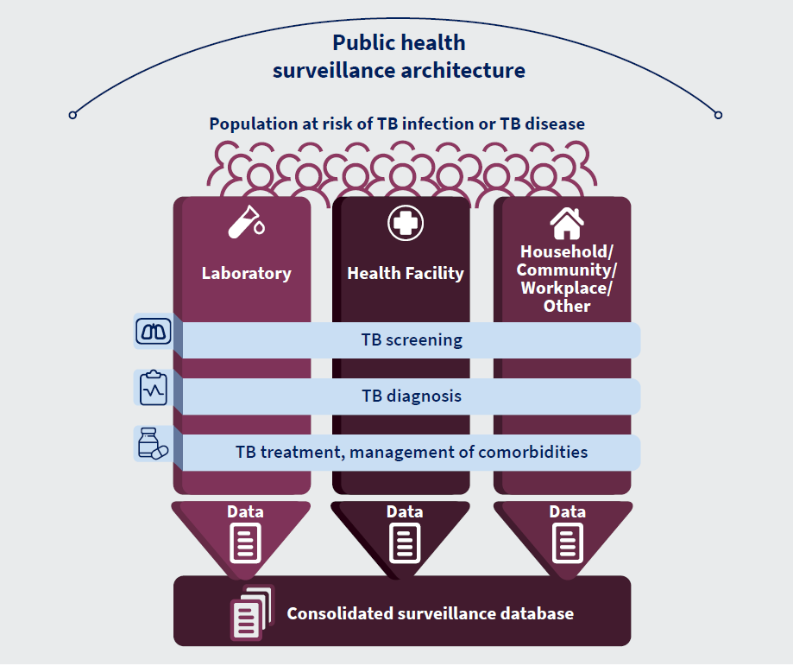
Background
Vision: unified, digital, case-based environment for TB surveillance.
Capturing, analysing and using data along the whole pathway of TB prevention and care.
Consolidation of data sources, avoiding fragmentation of information systems & project-based solutions.
Promoting integration with overall HIS plans.

Slide 4
Structure of presentation
DHIS2 modules
Aggregate
Case-based
tbhistoric.org
Digital Adaptation Kit for TB
Digital platform to support programme planning
Notes:
TO UPDATE

Slide 5
DHIS2

Slide 6
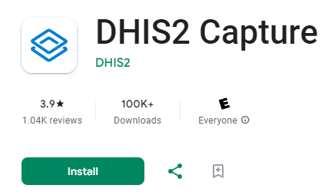
DHIS2
WHO dhis2 packages available for:
Aggregate data
or
Case-based data (aka TB tracker)
Both systems are alinged with global standards for recording and reporting of TB data
metadata* free for download:
https://dhis2.org/who/
Android App (online and offline functionality)
*Metadata = information needed for installing and configuring WHO DHIS2 packages on a local server.

Slide 7
TB registers (case-based)
DHIS2
Presumptive register
Lab registers
TB “treatment” (case) register
Household contact register and TPT
TB reporting forms (aggregate)*
quarterly report forms
*There is no need for quarterly report forms for case-based system. The data can remain in case-based format at the national level. Otherwise, the system can aggregate the data at any level.

Slide 8
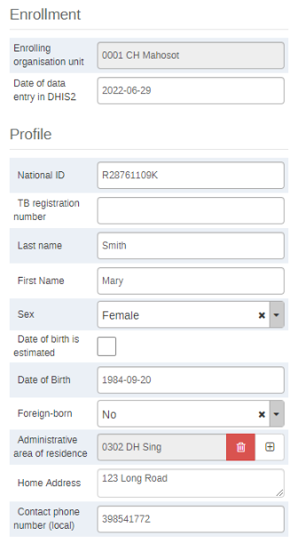
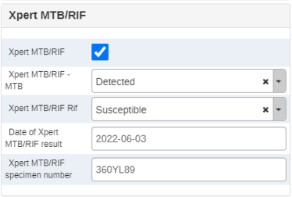
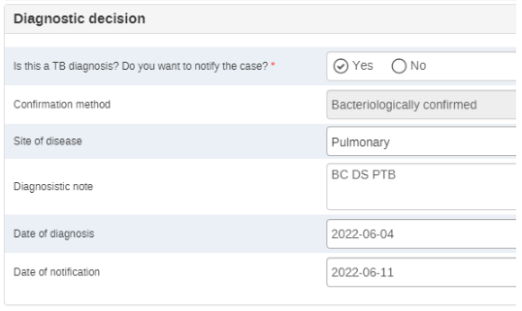
DHIS2
Metadata kist for local installation available for download: docs.dhis2.org
1. Aggregate system (HMIS)
2. Case-based system (TB Tracker)
Digital quarterly report forms
etc…
Digital registers
etc…

Slide 9
DHIS2: case-based tracker
TB cases are registered as notified case and “denotified” at outcomes stage if needed.
Blue: Stages for older WHO TB Tracker
Registration of TB case
Treatment regimen
Laboratory results
Outcomes
Green: Stages for WHO TB Tracker update
Registration of presumptive TB case
Treatment regimen
Laboratory testing and results
Outcomes
Diagnosis and notification
Presumptive TB cases sent for lab testing are registered and then diagnosed and notified (or not).
TB cases who have bypassed the lab and are clinically diagnosed can still be registered, diagnosed and notified.
Data related to case classification is shifted from registration stage to diagnosis stage.

Slide 10
DHIS2: case-based tracker
Dashboards populated
Routine analysis of standardised indicators
Opportunities at the lab:
Interoperability with LIS (UiO has had success with COVID module).
Connection with digital diagnostics (e.g. GeneXpert).
Full digitization of paper lab registers for TB.
Fill in the rest of the information and notify the case as per BAU
Clinical diagnosis
Not TB
Close
Differential diagnosis
Results recorded in dhis2
Demographic and
sample information recorded in dhis2
Positive
Negative
Record is updated with lab results
&
Line list is updated with lab results
Create record
Update record
No existing record
Existing record
Record is open with demographic information
&
Name added to line list with results pending
Look up patient in lab module
Sample and request form received at the lab
Health Facility: full access
Lab: access to registration and lab stage

Slide 11
DHIS2: case-based tracker
Objectives:
Recording of presumptive TB cases that are sent to the lab for testing.
Create a “link” with case surveillance system and sharing of lab testing results in real-time.
Minimise lab data linkage and quality issues, and support health facility on interpreting quality of lab results.
Sharing of data with TB programme such that the unit is appropriate for surveillance analysis (person vs test).
What the update does not do or isn't:
Not intended as a full laboratory information system.
Not fit for processes related to lab management.
Not intended to replace existing functional systems.

Slide 12
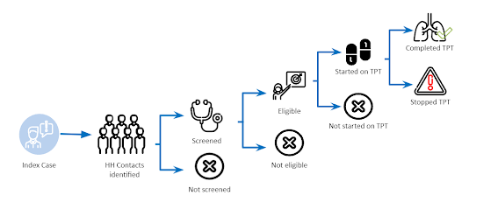
DHIS2: case-based tracker
Household contact tracing and TB prevention module:
Available in both aggregate package and as a case-based module (to link with case surveillance module)
In line with GTB guidelines for screening and prevention.
Data entry for key data elements.
Core indicators for routine monitoring.
Includes dashboards to facilitate analysis.
“WHO consolidated guidelines on tuberculosis: module 1: prevention: tuberculosis preventive treatment”.

Slide 13
DHIS2: tbhistoric.org
tbhistoric.org
Reflects the aggregate package
Hosted on a server managed by WHO/GTB
Offered to TB programmes to safeguard sunational data
Support analysis and visualisation of TB data during reviews and systematically
Analytical tool during training workshops on data analysis and use

Slide 14
DHIS2: planned updates
Updates coming in 2024
DHIS2 metadatakits:
Aggregate package
Case-based package
tbhistoric.org
Based on new TB surveillance guidance:
Data elements
Indicators
Dashboards

Slide 15
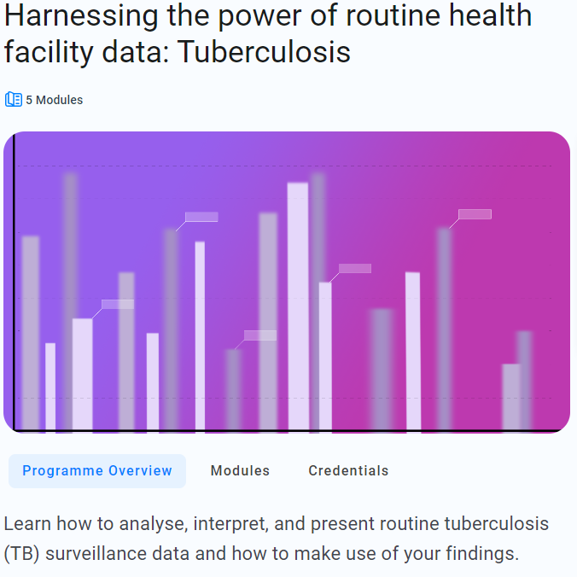
Resources to support data analysis and use
Download here
Update planned this year
(with DHIS2 modules)
Access the training here
Bientôt disponible en français

Slide 16
Evaluation of DHIS2 implementation

Slide 17
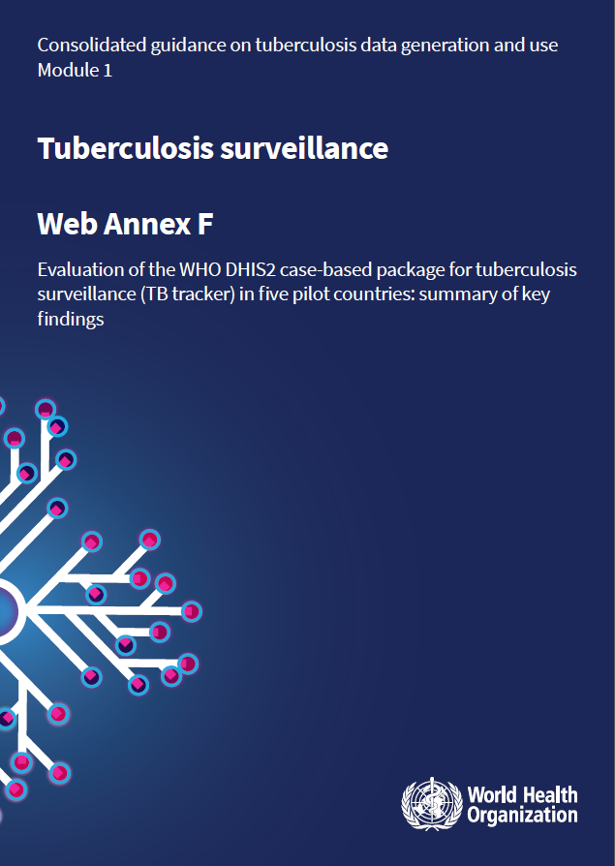
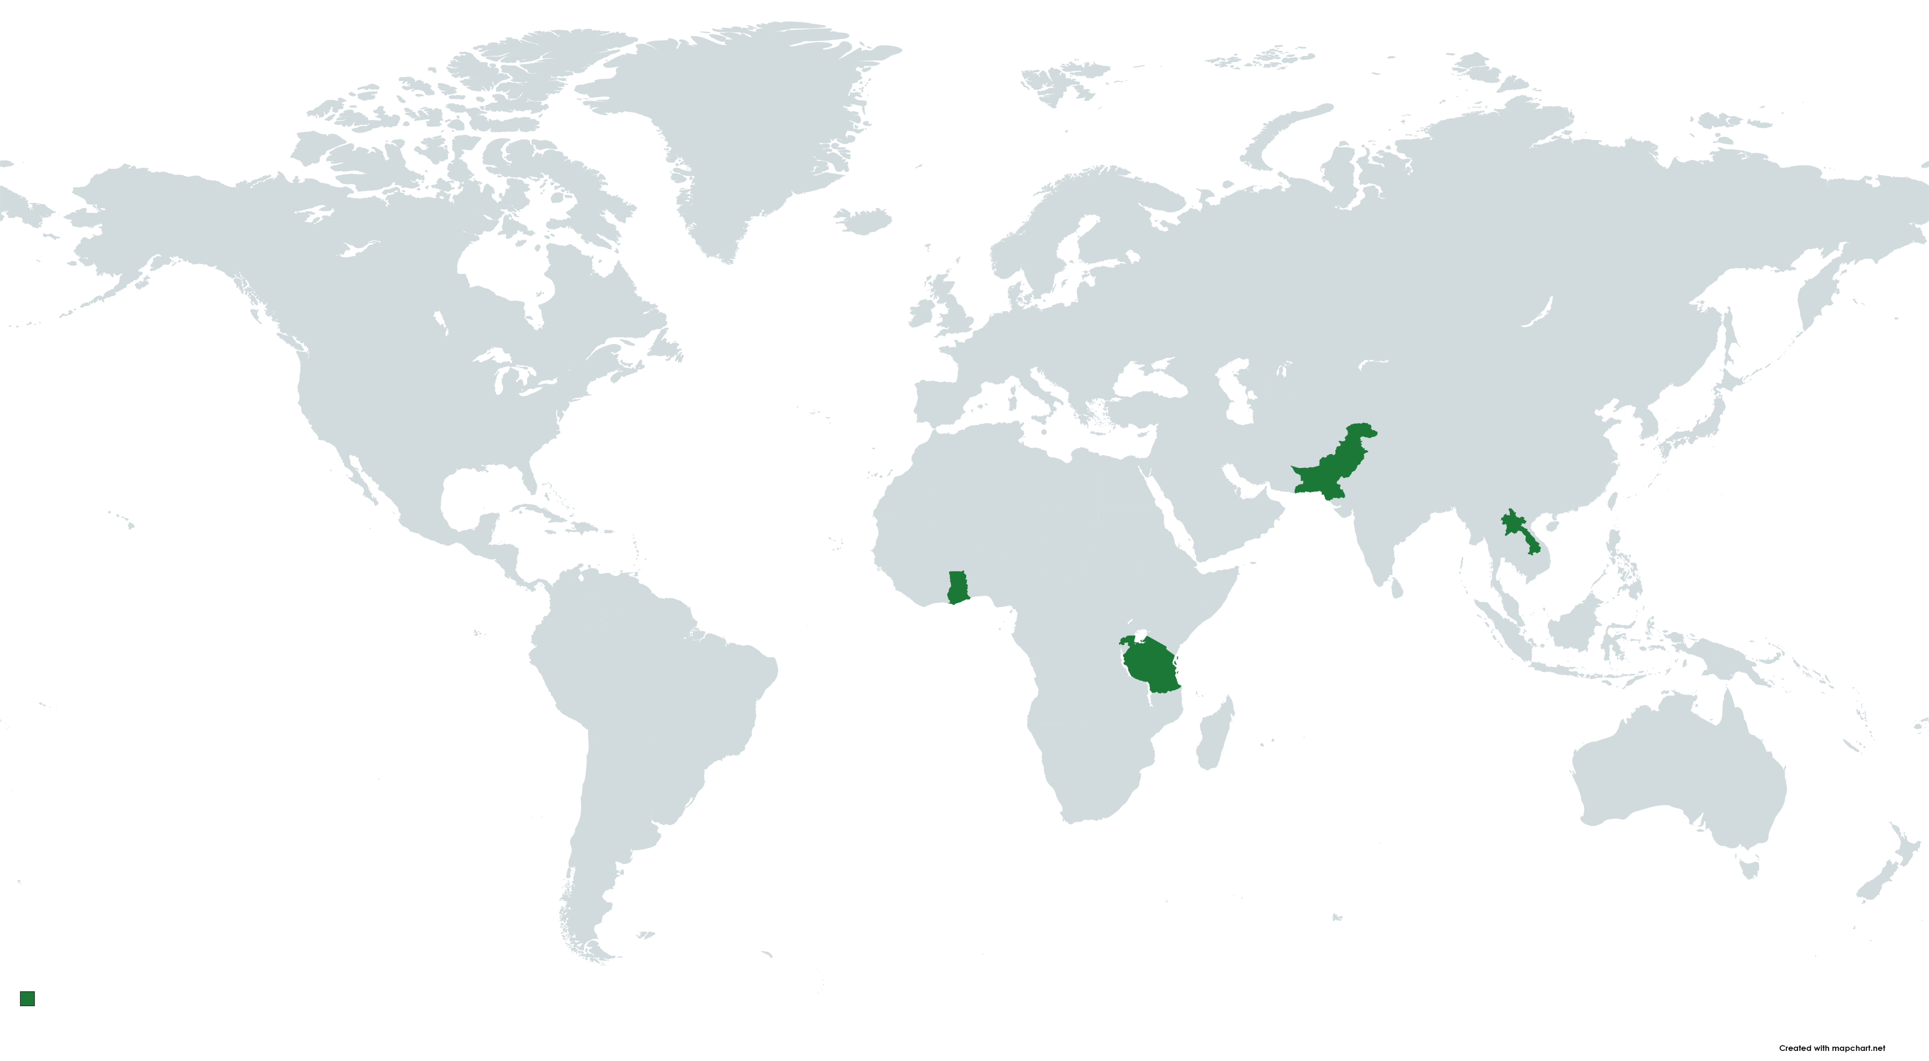
Evaluation of DHIS2 implementation
Evaluation conducted in 2020 by external evaluators (LogicalOutcomes & eSHIFT), with technical and coordination support by WHO
Ghana, Lao People's Democratic Republic, Pakistan, Rwanda and Tanzania

Slide 18
Evaluation of DHIS2 implementation
Methods: mixed-methods (quantitative and qualitative) design
Desk review of relevant documents
Survey of front-line workers
Semi-structured interviews
Data analysis
Report and synthesis
Global-level, country-level (provided by NTP and local partners), NGOs
UiO, Global Fund, NTP (national and sub-national units), HMIS, partners (e.g. HISP)
Considered as those who input data into DHIS2 (e.g. health facility workers, data entry clerks).
Qualitative data were analysed looking for emerging themes and specific pertinent information.
Report on findings, strategies to mitigate challenges, recommendations.
The evaluation was undertaken across seven dimensions:
Relevance and appropriateness of dhis2 TB tracker to meet country needs and expectation.
Implementation of dhis2 TB tracker and operations
Effectiveness of dhis2 TB tracker in relation to global and country-level goals and objectives
Sustainability of implementation and use
Key factors that facilitate implementation
Key factors that hinder implementation
Identifying best practices

Slide 19
Evaluation of DHIS2 implementation
Summary of best practices to increase chances of successful implementation that emerged from the evaluation:
1. Robust strategy for planning, design, implementation and use:
Clear digital health information strategy that highlights the need for a patient-centric platform.
Clear implementation and M&E strategy for piloting and staged scale-up.
Needs to consider staffing, funding, infrastructure, maintenance and support.
Notes:
Clear digital health information strategy that highlights the need for a patient-centric data platform, with centralised elements for coordination and decentralised elements for implementation and support.
Clear implementation and M&E plan to support piloting and staged scale-up.
Staffing, funding, maintenance and support need to be considered.

Slide 20
Evaluation of DHIS2 implementation
Summary of best practices to increase chances of successful implementation that emerged from the evaluation:
2. Strong governance of the process, strong involvement of the NTP:
Multisectoral approach, with buy-in from all relevant stakeholders (at all levels)
Strong political commitment from the MoH
Stakeholders need to have a long-term aligned commitment to a chosen technology and approach to collaboration
Notes:
Multisectoral approach, with buy-in from all relevant stakeholders at all levels, strong political commitment from the MoH.
Ensuring stakeholders (e.g. NTP, HMIS, MoH) have a long-term aligned commitment to a chosen technology and approach to collaboration.

Slide 21
Evaluation of DHIS2 implementation
Summary of best practices to increase chances of successful implementation that emerged from the evaluation:
3. Levering and building on existing experience and knowledge of DHIS2:
Integrating DHIS2 within a coherent public health surveillance architecture
Access support from experienced local teams and international partners
Notes:
Integrating DHIS2 within a coherent health system architecture.
Access high-quality technical support from experienced local teams within the MoH (e.g. HMIS) or international partners (e.g. HISP).

Slide 22
Evaluation of DHIS2 implementation
Summary of best practices to increase chances of successful implementation that emerged from the evaluation:
4. Strong supportive procedures and policies:
Decentralised, with strong middle-layer of support and communication across layers
Strong community of practice to support learning and development
Virtual working groups to facilitate discussion of issues and challenges in real-time.
Notes:
Integrating DHIS2 within a coherent health system architecture.
Access high-quality technical support from experienced local teams within the MoH (e.g. HMIS) or international partners (e.g. HISP).
Strong middle-layer of support with communication across layers to enable district coordinators to monitor and support staff in their administrative units.
Strong community of practice (e.g forums) to support learning and development and/or a virtual working group to facilitate discussion of issues and challenges in real-time.

Slide 23
Digital Adaptation Kit (TB-DAK)

Slide 24
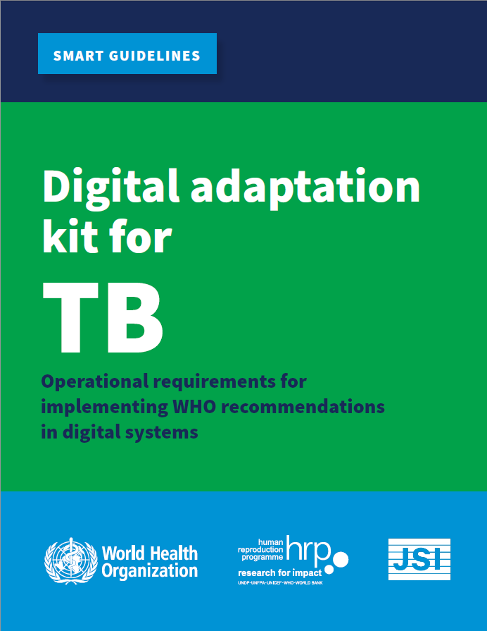
Digital Adaptation Kit for TB (TB-DAK)
Software-agnostic requirements package to inform the development of digital systems that are aligned with TB guidelines and associated M&E
1. Interventions & recommendations
2. Generic personas
3. User scenarios
Building on existing TB narrative: clinical guidelines, eTB guidelines, TB knowledge sharing platform, PREVENT TB, WHO DHIS2 TB, guidance on TB surveillance
4. Business processes & workflow
5. Core data elements
6. Decision support logic
7. Indicators & monitoring
Contact:
Gita Parwati parwatic@who.int
Marek Lalli lallim@who.int
Babis Sismanidis sismanidisc@who.int
8. Functional and non-functional requirements
Notes:
1. Section that includes the interventions and recommendations for all GTB guidelines
4. It includes workflows that represent both clinical and non-clinical processes for each programmatic area.
6. Lists the requirements for developing decision support logic, which includes algorithms to help health workers take clinical decision.
7. There is a detailed description of the indicators for reporting and how these are calculated.
5. Lists the core data that need to be collected which will feed into the decision support logic and the used to calculate the core indicators.

Slide 25
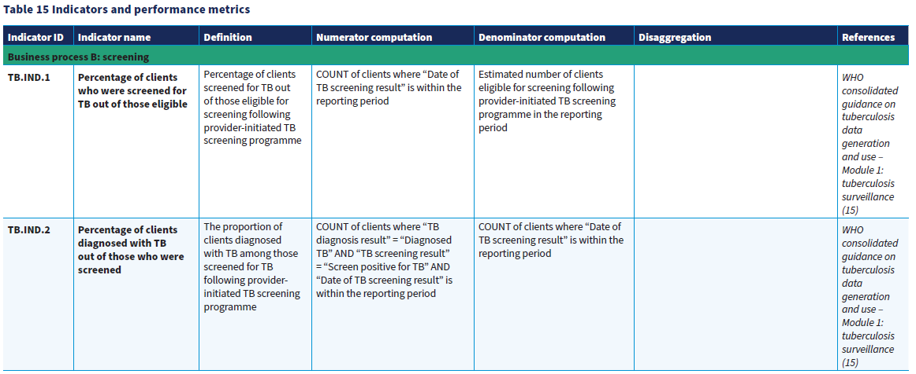
Digital Adaptation Kit for TB (TB-DAK)
Notes:
1. Section that includes the interventions and recommendations for all GTB guidelines
4. It includes workflows that represent both clinical and non-clinical processes for each programmatic area.
6. Lists the requirements for developing decision support logic, which includes algorithms to help health workers take clinical decision.
7. There is a detailed description of the indicators for reporting and how these are calculated.
5. Lists the core data that need to be collected which will feed into the decision support logic and the used to calculate the core indicators.

Slide 26
Digital platform to support programme planning

Slide 27
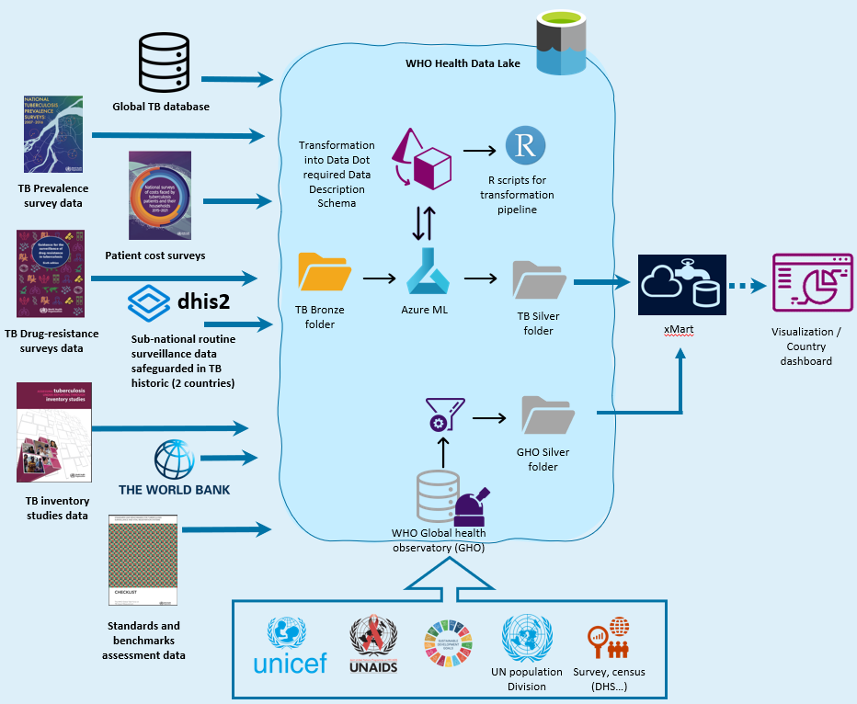
Digital platform to support programme planning
In collaboration with World Health Data Hub (WHDH) at WHO
Platform to collate data from multiple sources and visualise them on a series of dashboards.
Surveillance - national: 68 indicateurs
Surveillance - subnational: 15 indicateurs
Prevalence surveys: 13 indicateurs
Patient cost surveys: 18 indicateurs
Drug resistance surveys: 8 indicateurs
Inventory study: 10 indicateurs
World Bank: 5 indicateurs
Standards and Benchmarks: 7 indicateurs
Global Health Observatory: 23 indicateurs
One stop shop for core data needed for strategic planning
Public data will remain public, private data (e.g. subnational notifications) will be password protected.
Planned training on the platform use.
Contact:
Gita Parwati parwatic@who.int
Babis Sismanidis sismanidisc@who.int
Notes:
TO UPDATE

Slide 28
Thank you

