Slide 1
Global Plan to End TB 2023-2030
Africa Regional Workshop on Strengthening TB Monitoring & Evaluation Systems
Dar es Salaam, Tanzania, 16-19 April 2024

Slide 2
Outline
Reflections from the workshop
Global Plan Overview
Objectives & targets
Funding
Some implementation resources

Slide 3
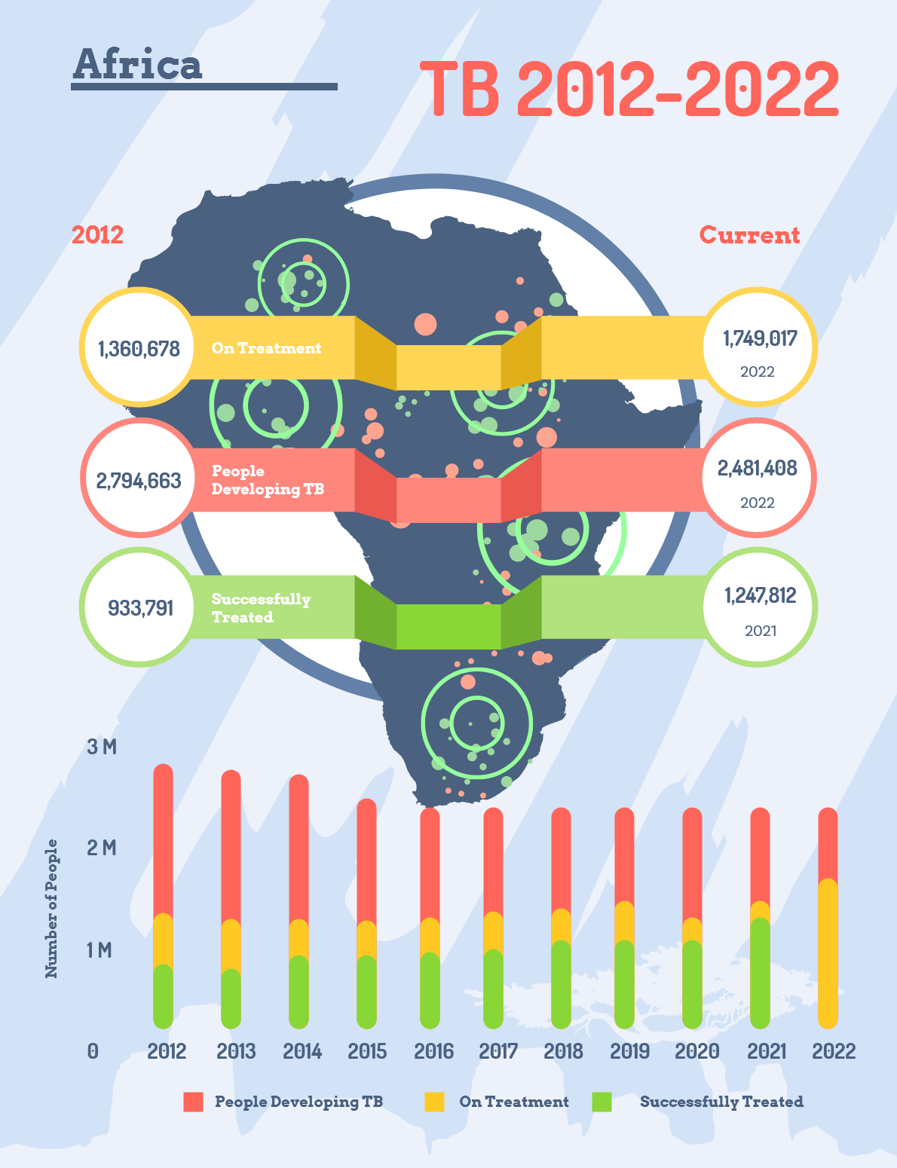
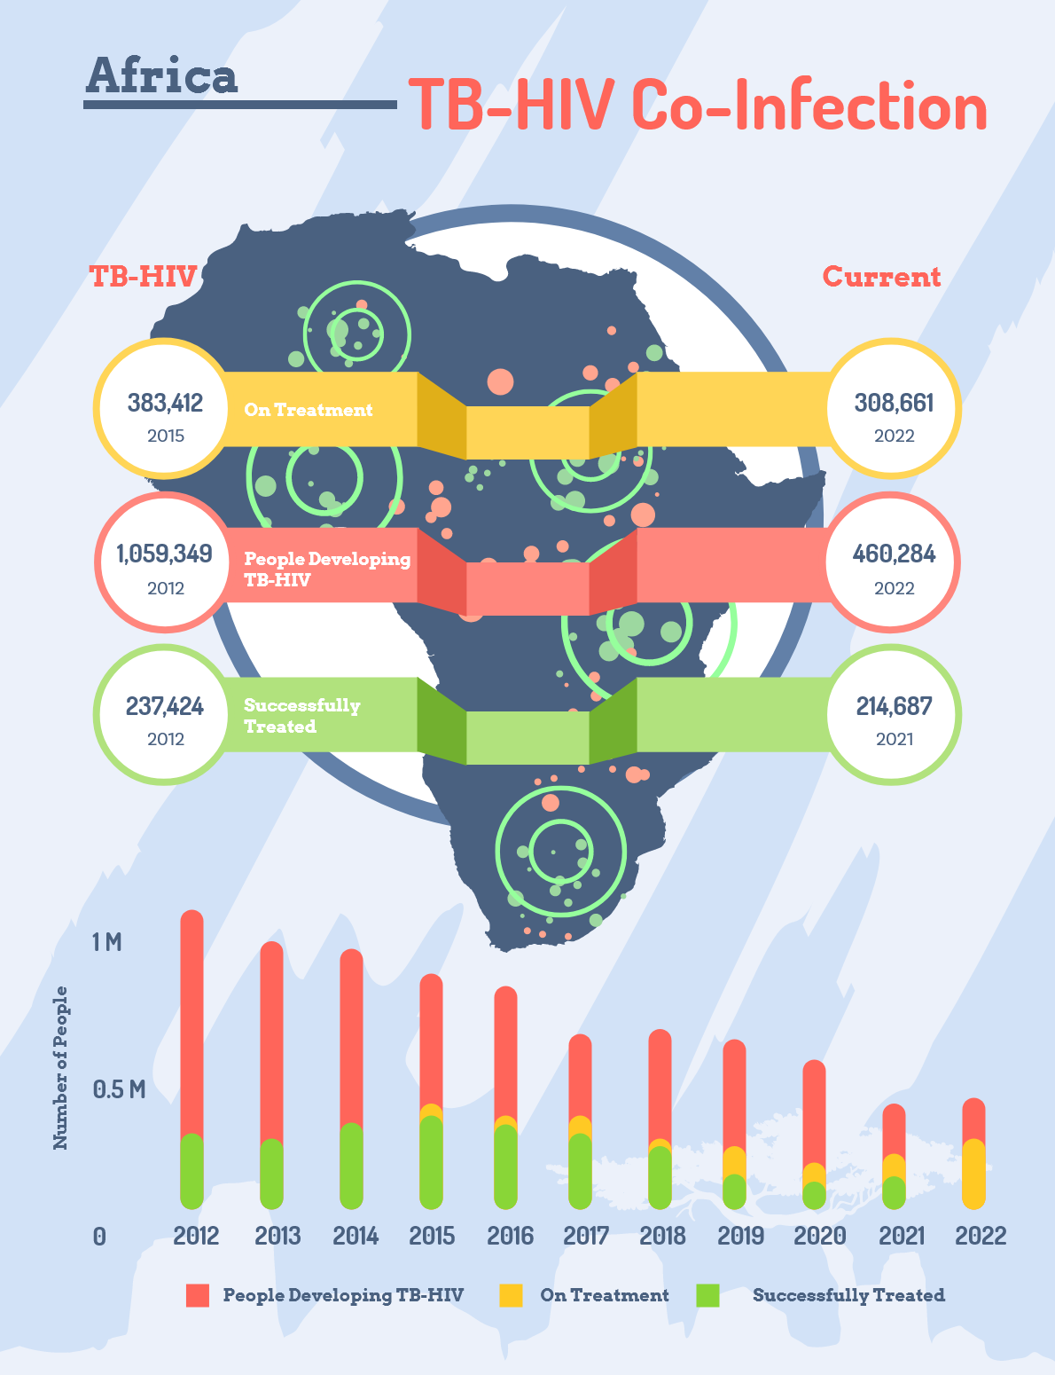

Slide 4
Excellent data use practices
TB situation room – Zambia, Malawi, NGA
Using data to track access to WHO endorsed diagnostics & quality of diagnosis – Moz, TZ, Zambia
Using data for sub-national tailoring: Ethiopia, DRC, NGA , SA
Using data to highlight gaps in men: NGA,SA
Triangulation of data/Linking lab data and backbone TB HMIS: Kenya , SA
TB Think Tanks
Data on the `left`’ of care cascade: presumptive, testing data
TB Data for action-Union Zim
Using Epi review reports

Slide 5
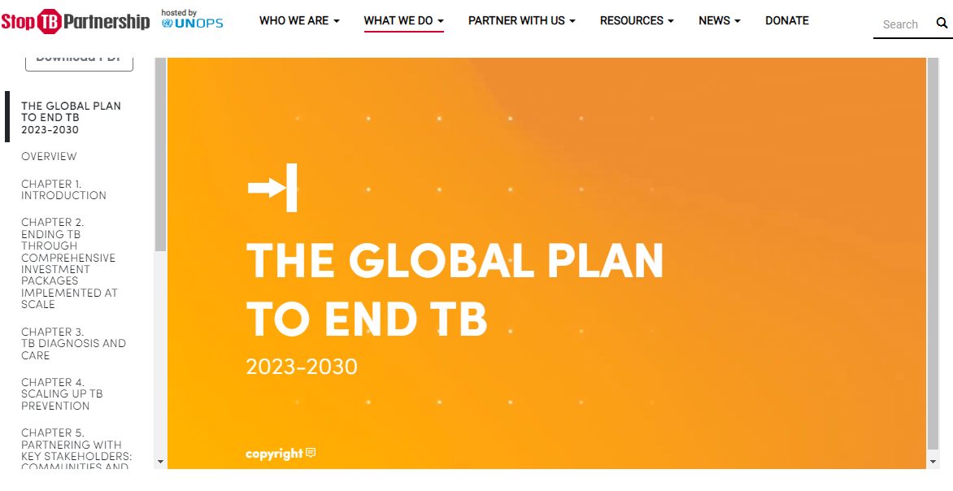
The Global Plan
Comprehensive set of policy interventions
Roadmap and detailed budget estimates for ending TB as a public health challenge by 2030
6%
(12%)
https://www.stoptb.org/global-plan-to-end-tb/global-plan-to-end-tb-2023-2030
Notes:
.

Slide 6
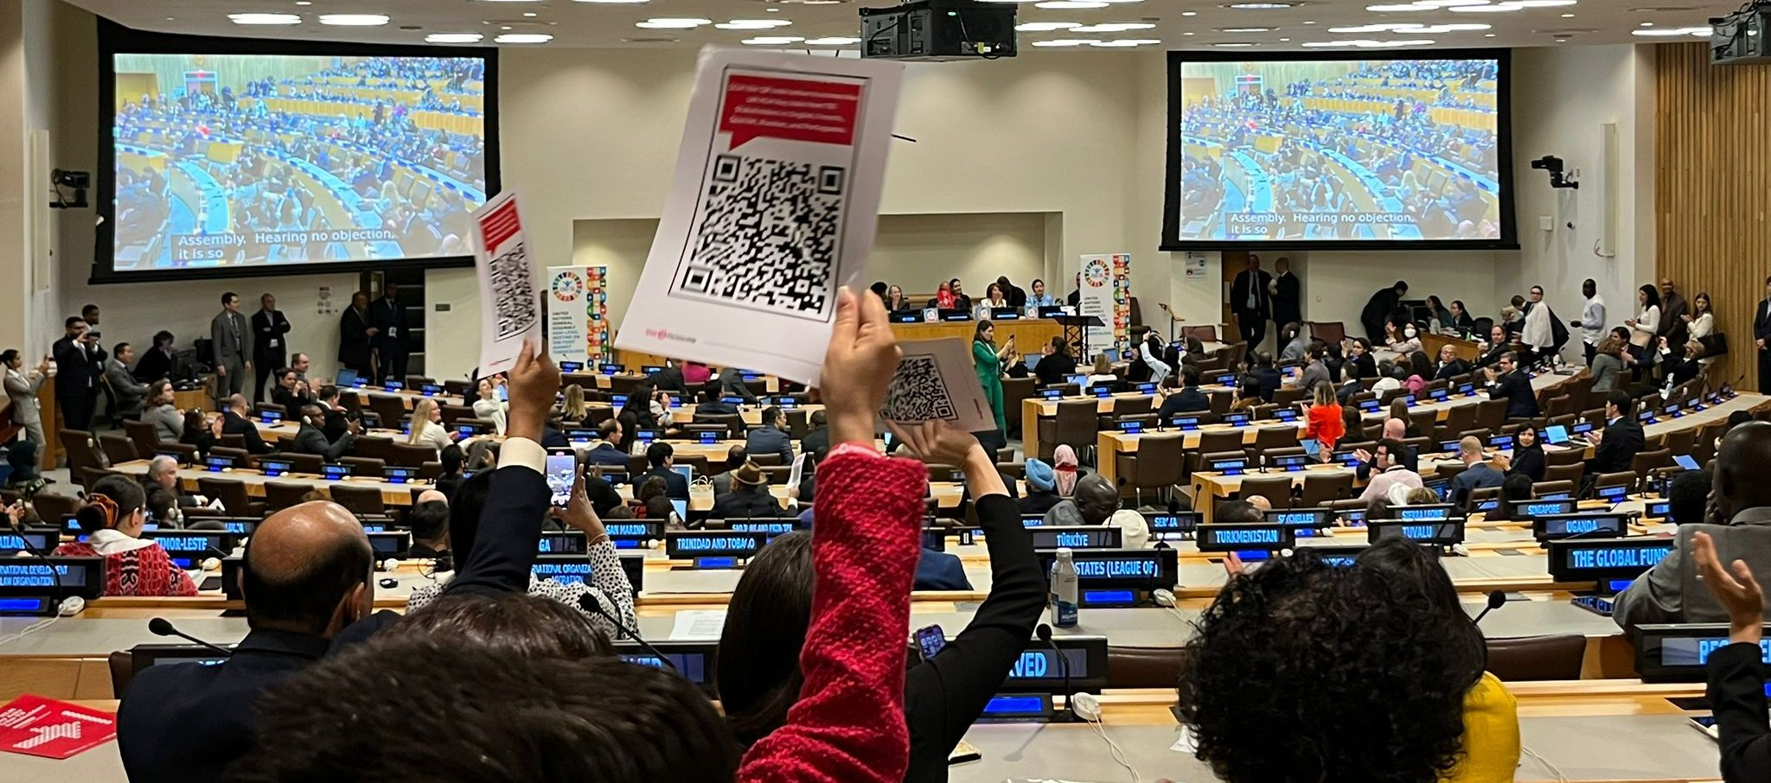
United Nations High-Level Meeting on Tuberculosis: 22 September 2023
2023 UNGA Political Declaration on the fight against TB
The Declaration contains the most ambitious targets to date in the fight against TB to put the world on track to ending TB by 2030.
Key highlights:
Member states committed to:
Providing life-saving treatment for up to
45 million people between 2023 and 2027,
including up to 4.5 million children and up to 1.5 million people with drug-resistant tuberculosis;
Providing preventive treatment for up to
45 million people
including 30 million household contacts of people with tuberculosis, including children and
15 million people living with HIV.
Member states also committed to:
Increasing annual global TB funding levels to over four times the current level ($5.4 billion) towards reaching $22 billion annually by 2027, increasing to $35 billion by 2030
Mobilize $5 billion a year by 2027 for tuberculosis research and innovation - a five times increase from the current $1 billion a year - towards the development of point of care diagnostics, vaccines for all forms of tuberculosis, and shorter, safer and more effective treatment regimens.
6%
(12%)
Notes:
.

Slide 7
Global Plan to End TB 2023-2030 Key Targets set based on impact modelling
GP Chapters | Targets to achieve by 2030
Deliver early diagnosis and TB treatment and care | Find and diagnose at least 95% of people with TB, including drug-susceptible (DS-) and DR-TB in adults and children. More than 90% of pulmonary TB should be diagnosed by rapid molecular tests, and more than 90% of bacteriologically identified TB strains should have DST before initiating treatment. Deliver treatment to 50 million people from 2023 to 2030, including 4.7 million children and 3.32 million people with rifampicin-resistant (RR-) or multidrug-resistant (MDR-) TB. Initiate appropriate treatment for all people diagnosed with TB. Achieve at least 90% treatment success for all forms of TB.
Prevent TB transmission, infection and disease | Provide TPT to 100% of eligible contacts of people with TB. Provide TPT to 100% of PLHIV. Provide TPT to 35 million people at risk of TB. Develop at least one new TB vaccine to be recommended for use in 2025 and rolled out in 2026. Achieve at least 60% target population coverage with a new vaccine by 2030.
Implement enablers and strengthen systems | At least 90% of countries have a communities, rights and gender (CRG) action plan, budget line and monitoring mechanism. At least 90% of countries have identified key and vulnerable populations in their national TB plans, have proposed specific actions, and have a budget line and monitoring mechanism in place. At least 90% of countries that anticipate implementing a new TB vaccine have a vaccine readiness plan.
Accelerate R&D of new TB tools | Achieve the goals and objectives set in the Global Plan’s strategic frameworks for vaccines, diagnostics and medicines.
Mobilize resources to implement the Global Plan | Mobilize US$ 209.8 billion for TB programmes and enabling interventions from 2023 to 2030. Mobilize US$ 33.8 billion for R&D for new TB medicines, diagnostics and vaccines from 2023 to 2030. Mobilize at least US$ 6.4 billion for TB basic science research.
6%
(12%)
Notes:
.

Slide 8
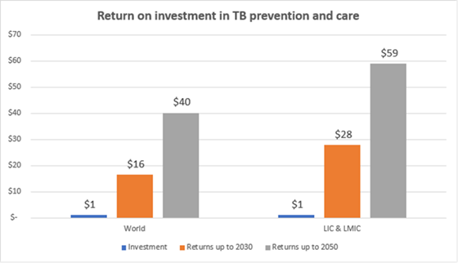
Global Plan to End TB 2023-2030
Resource needs 2023-2030 (all sources):
Total need: US$ 250 billion (US$ 31.2 billion per year on average):
US$ 157.2 billion for TB care and prevention (on average to US$ 19.65 billion per year)
US$ 52.6 billion for vaccination once a new vaccine is available
US$ 40.2 billion for TB R&D and basic science research
The increase in funding is needed to make up for lost progress due to COVID-19, to accelerate development and introduction of new TB tools – including at least one new vaccine – and to make up for financing gaps in previous years.
6%
Return on investment
The Global Plan is an investment in human lives and economic productivity.
Modelling projects a strong return on this investment:
every dollar invested will deliver US$ 40 in economic return in benefits projected through 2050;
low-income and lower middle-income countries will see an even greater return of US$ 59 in economic benefits for every dollar invested.
Cost of inaction
Immense human and economic losses will be incurred if the ‘status quo’ continues through 2030:
additional 43 million people would develop TB, leading to 6.6 million additional TB deaths;
global economic cost of US$ 1 trillion;
loss of 234 million disability-adjusted life years (DALYs).
(12%)
Notes:
.

Slide 9
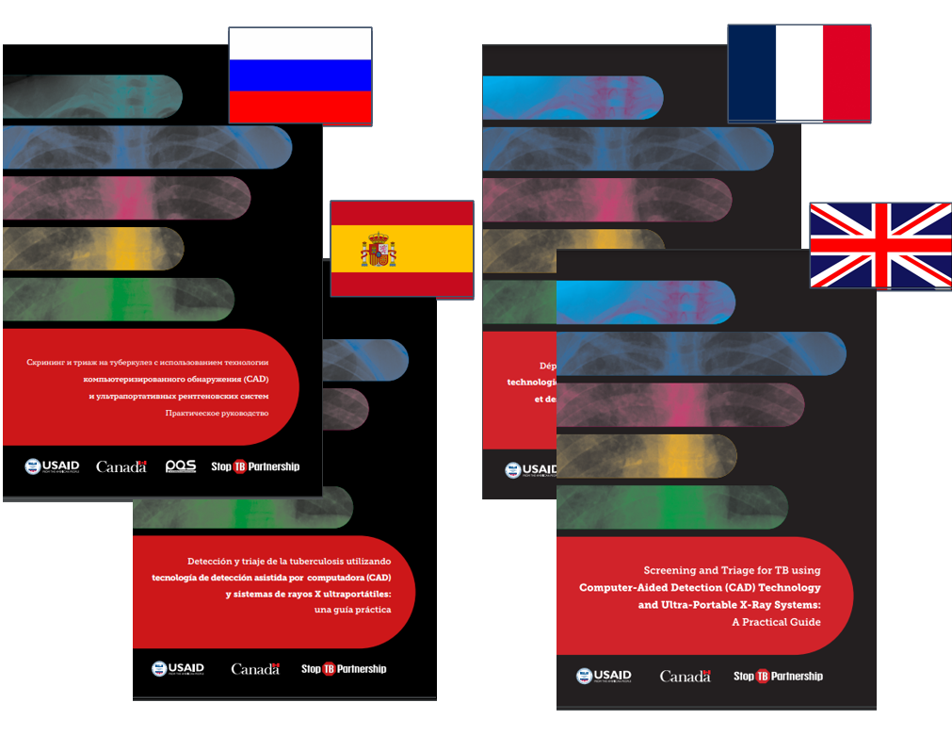
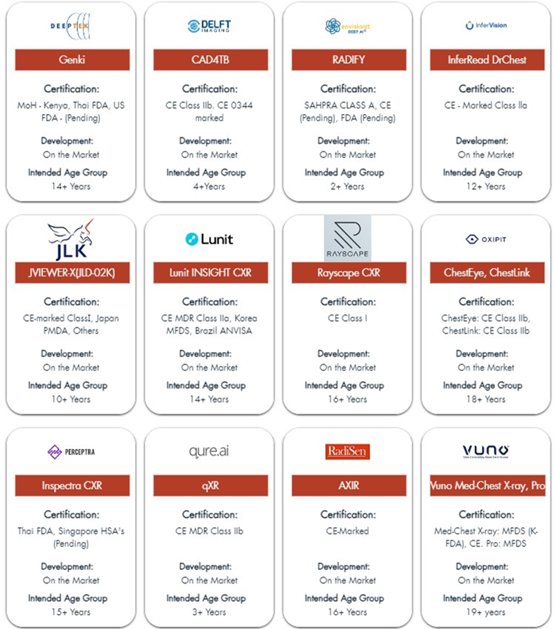
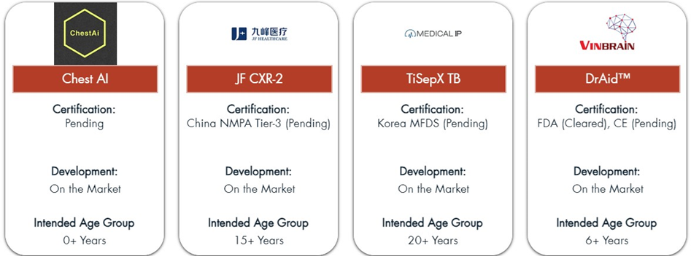
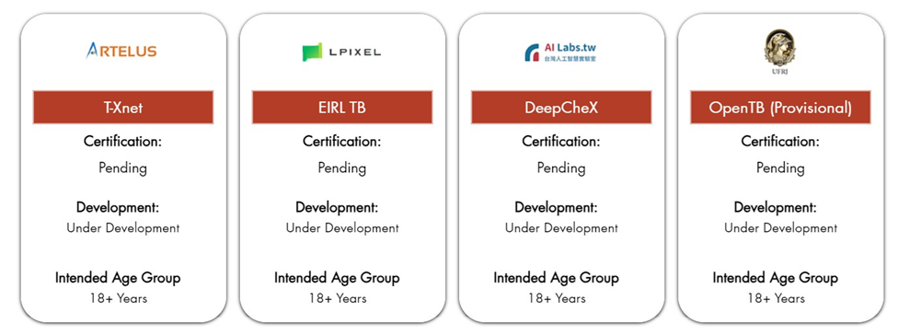
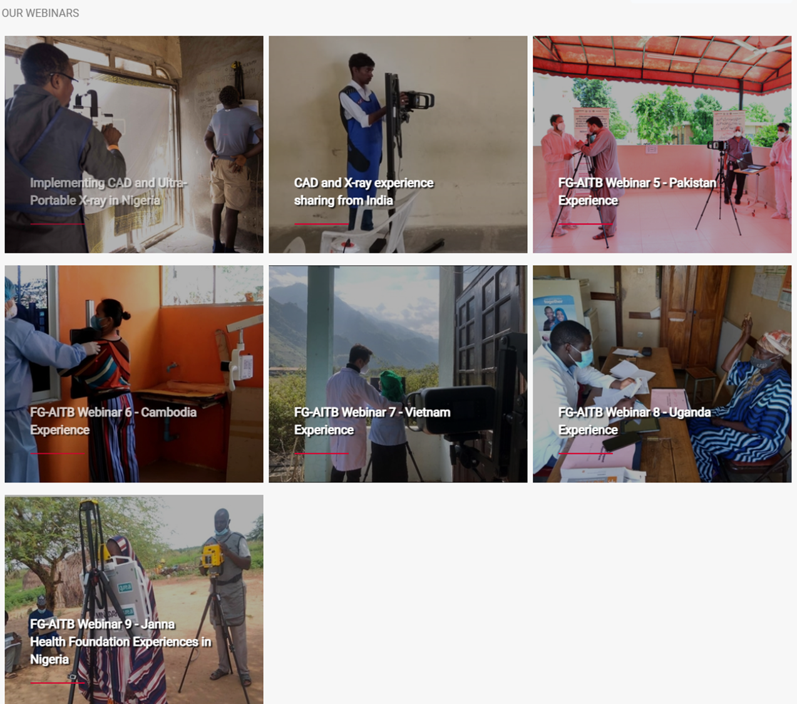
Useful Implementation Resources
Deliver early diagnosis
Stop TB's Practical Guide, created with the support of USAID and Global Affairs Canada, offers implementation guidance on designing large-scale X-ray CAD screening programs
CAD and X-ray Practical Implementation Guide | Stop TB Partnership
Stop TB has developed 5 training modules to support implementers of UP-XR and CAD. Two sets of these modules, tailored to decision makers and clinicians respectively, are available to download from the training modules page.
Additional training resources on radiography from USAID’s Infectious Disease Detection and Surveillance project (IDDS) are also available.
CAD and X-ray Training Modules | Stop TB Partnership
AI Landscape: www.ai4hlth.org
Focus group for AI-TB Webinars Focus Group on AI-based Imaging for TB | Stop TB Partnership
6%
(12%)
Notes:
.

Slide 10
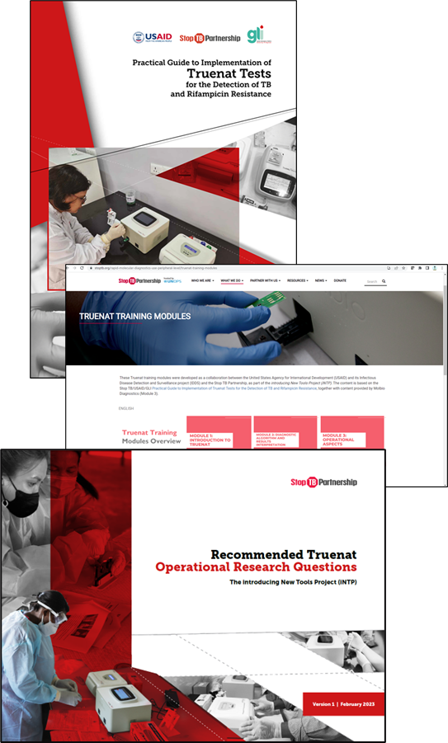
Useful Implementation Resources
Deliver early diagnosis
Practical Guide to Implementation of True nat (ENG/FR)
Developed by Stop TB and USAID, endorsed by GLI
Provides background on how Truenat works, test performance, steps and guidance for implementation, model algorithm, checklists for site selection and site readiness, SOPs, etc
Training Package, for country customization IENG/FR)
Developed as a collaboration between IDDS, USAID and Stop TB; endorsed by GLI
Includes 6 training modules, including specific modules intended for lab and program managers, lab technicians and clinicians
Recommended operational research questions
Including on acceptability, feasibility, impact and costs and cost-effectiveness
6%
(12%)
https://www.stoptb.org/introducing-new-tools-project/resources-implementation
Notes:
.

Slide 11
Useful implementation resources
6%
(12%)
https://www.stoptb.org/communities-rights-and-gender-crg/tools-to-support-communities-rights-and-gender-tb-responses
Notes:
.

Slide 12
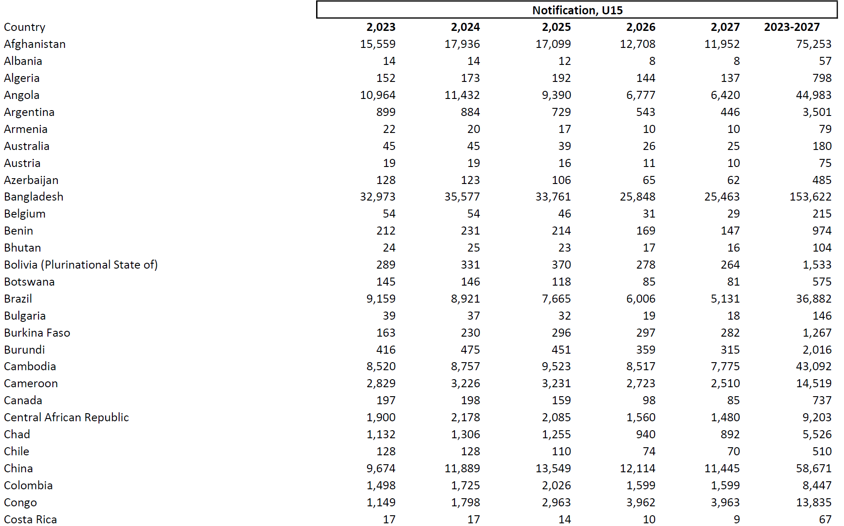
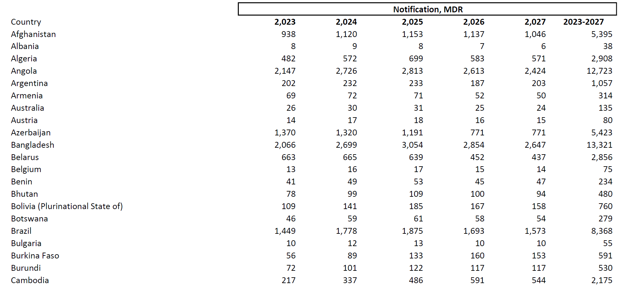
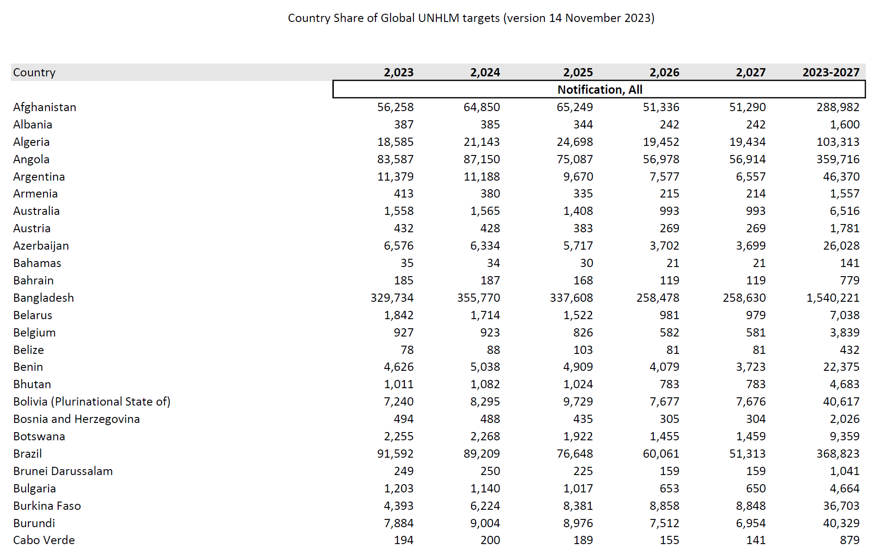
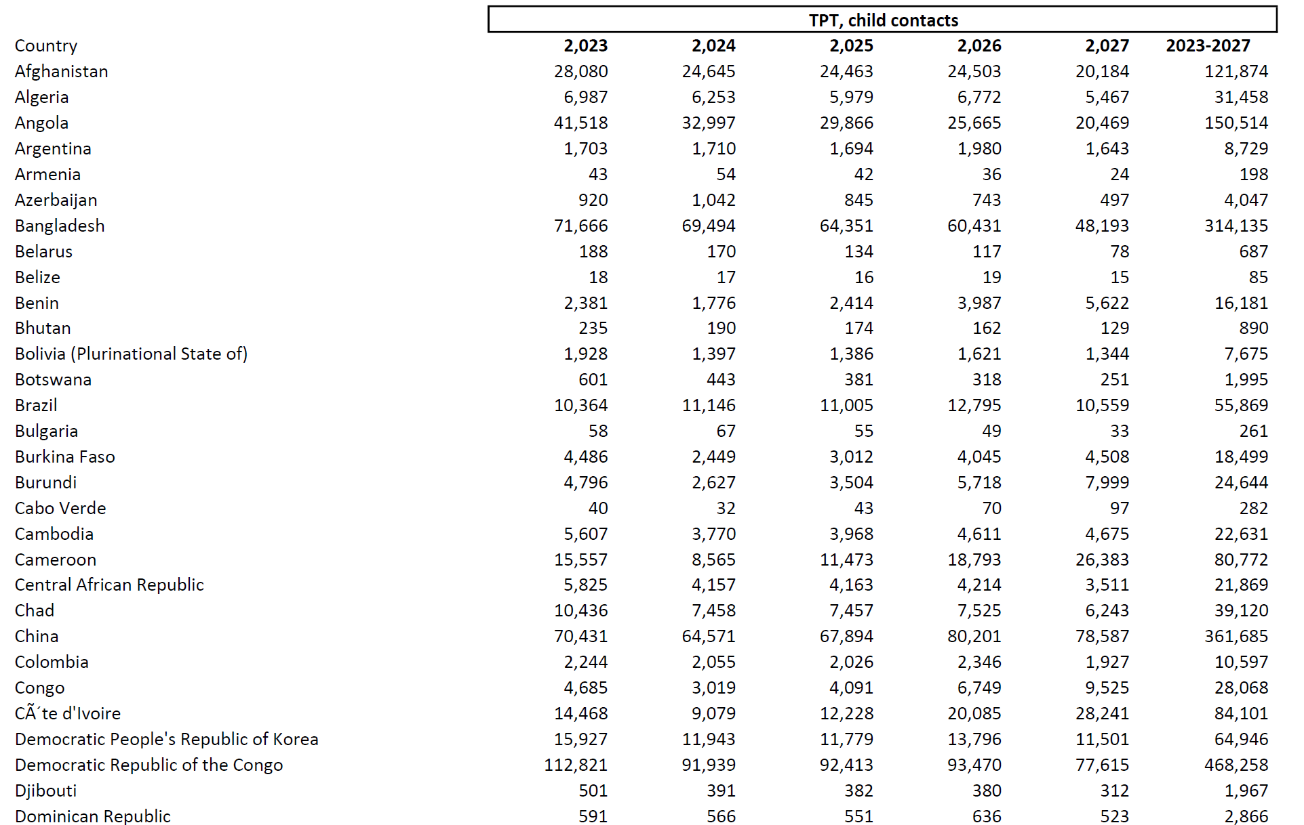
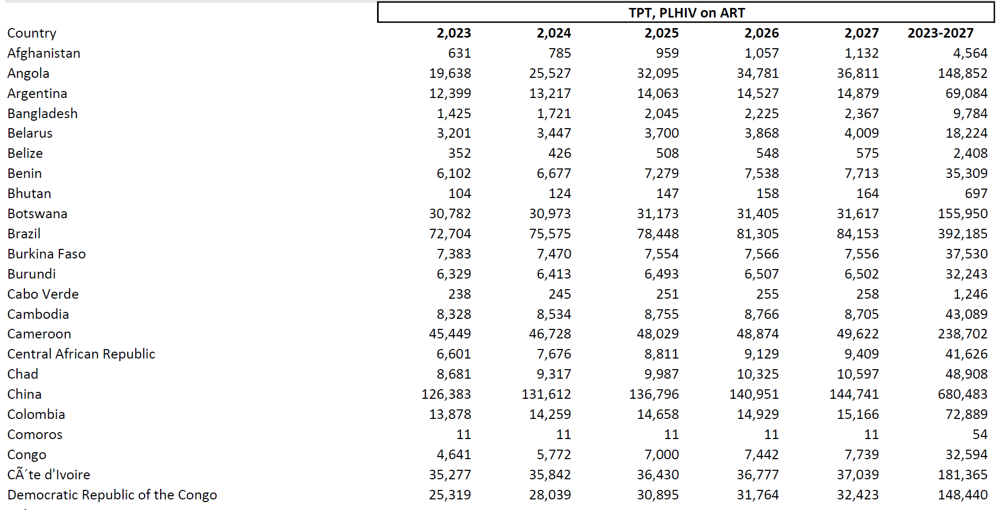
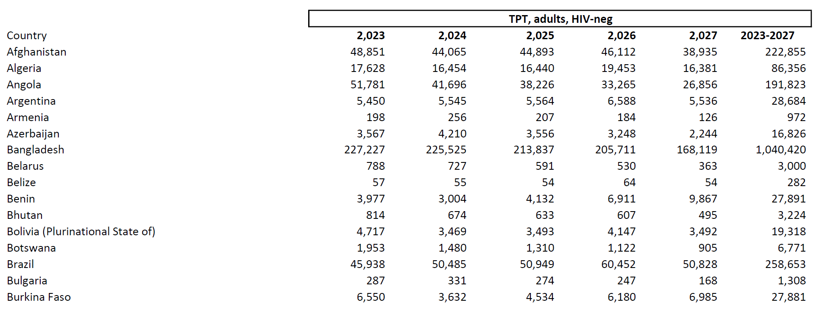
United Nations High-Level Meeting (UNHLM) Targets- Country Share of Global 2023 UNHLM Targets
6%
Friday, November 17, 2023 - 12:30 to 17:00
Hotel du Collectionneur, 51-57 Rue de Courcelles, 75008 Paris
(12%)
Notes:
.

Slide 13
www.stoptb.org
Notes:
PF

