Slide 1
Africa Regional Workshop on Strengthening TB Monitoring and Evaluation Systems; 16-19 April, 2024 • Dar es Salaam, Tanzania
Nigeria TB Situation Room
……….. for real-time decision making
Dr. Obioma Chijioke-Akaniro
Logo

Slide 2
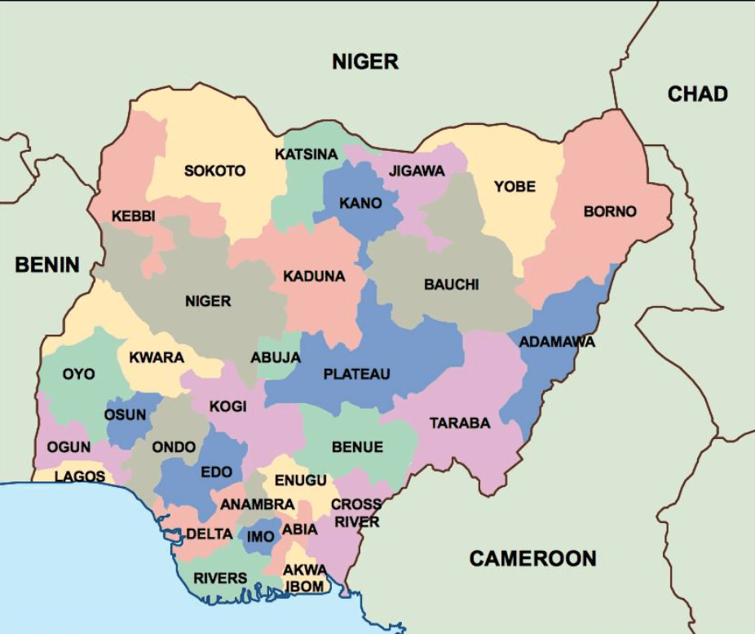
Background
Population:
223,804,632 (World Bank 2023)
Number of states and sub regions
36 states and Federal capital territory grouped into 6 geopolitical zones
2023 Annual case Notification:
285,561
TB treatment coverage: 70%

Slide 3
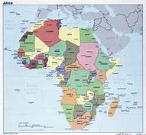
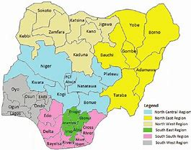
Data Trend is important
479,000 (19%)
2,480,000
People with TB in 2022
One person every 13s
One person every 1Min
TB deaths in 2022
424,000
97,900 (23%)
One person every 5 minutes
One person in
1Min

Slide 4
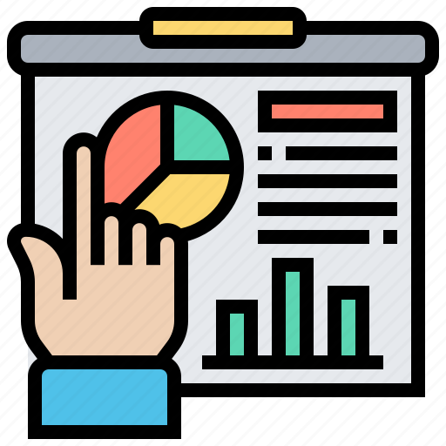
Context
Data use is important in public health service delivery, including for TB services.
TB data is critical to establish and assess the impact of interventions,
monitor progress toward improved patient care,
determine barriers to care, and influence public policy.
TB DIAH supported the National TB Program to:
upgrade existing central level TBSR at the NTP’s office
Established 3 TBSR at the sub-national level (Kano, Osun, Anambra States)
Access to real-time or near real-time data
Multi- layered data review and analysis
Data visualization
Collaboration and communication tools:
Data security and privacy

Slide 5
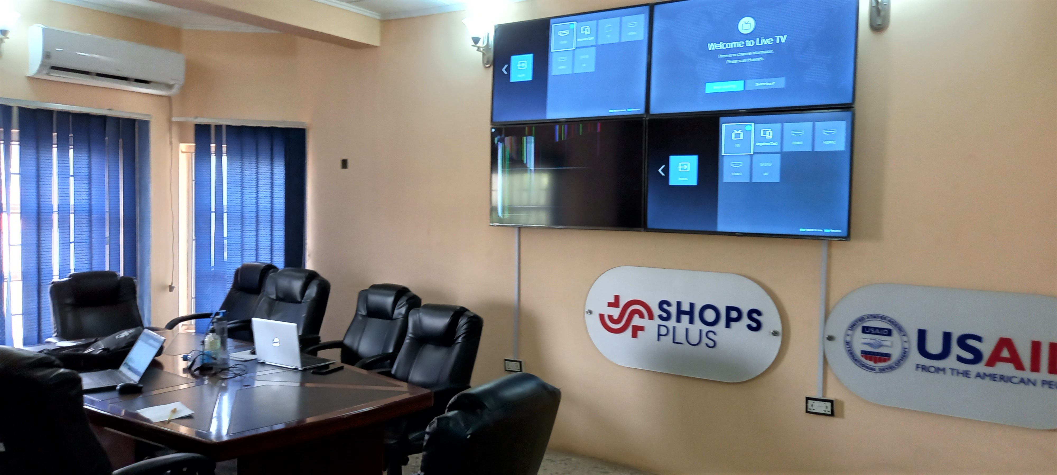
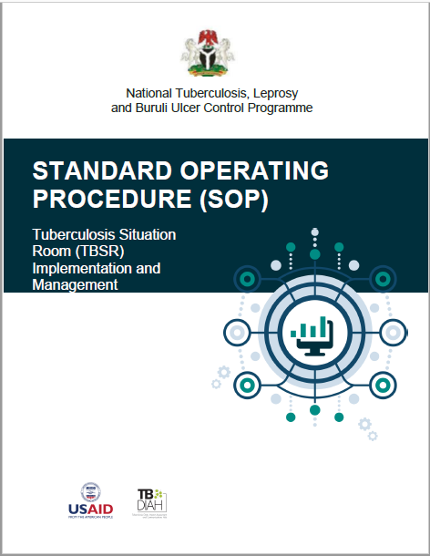
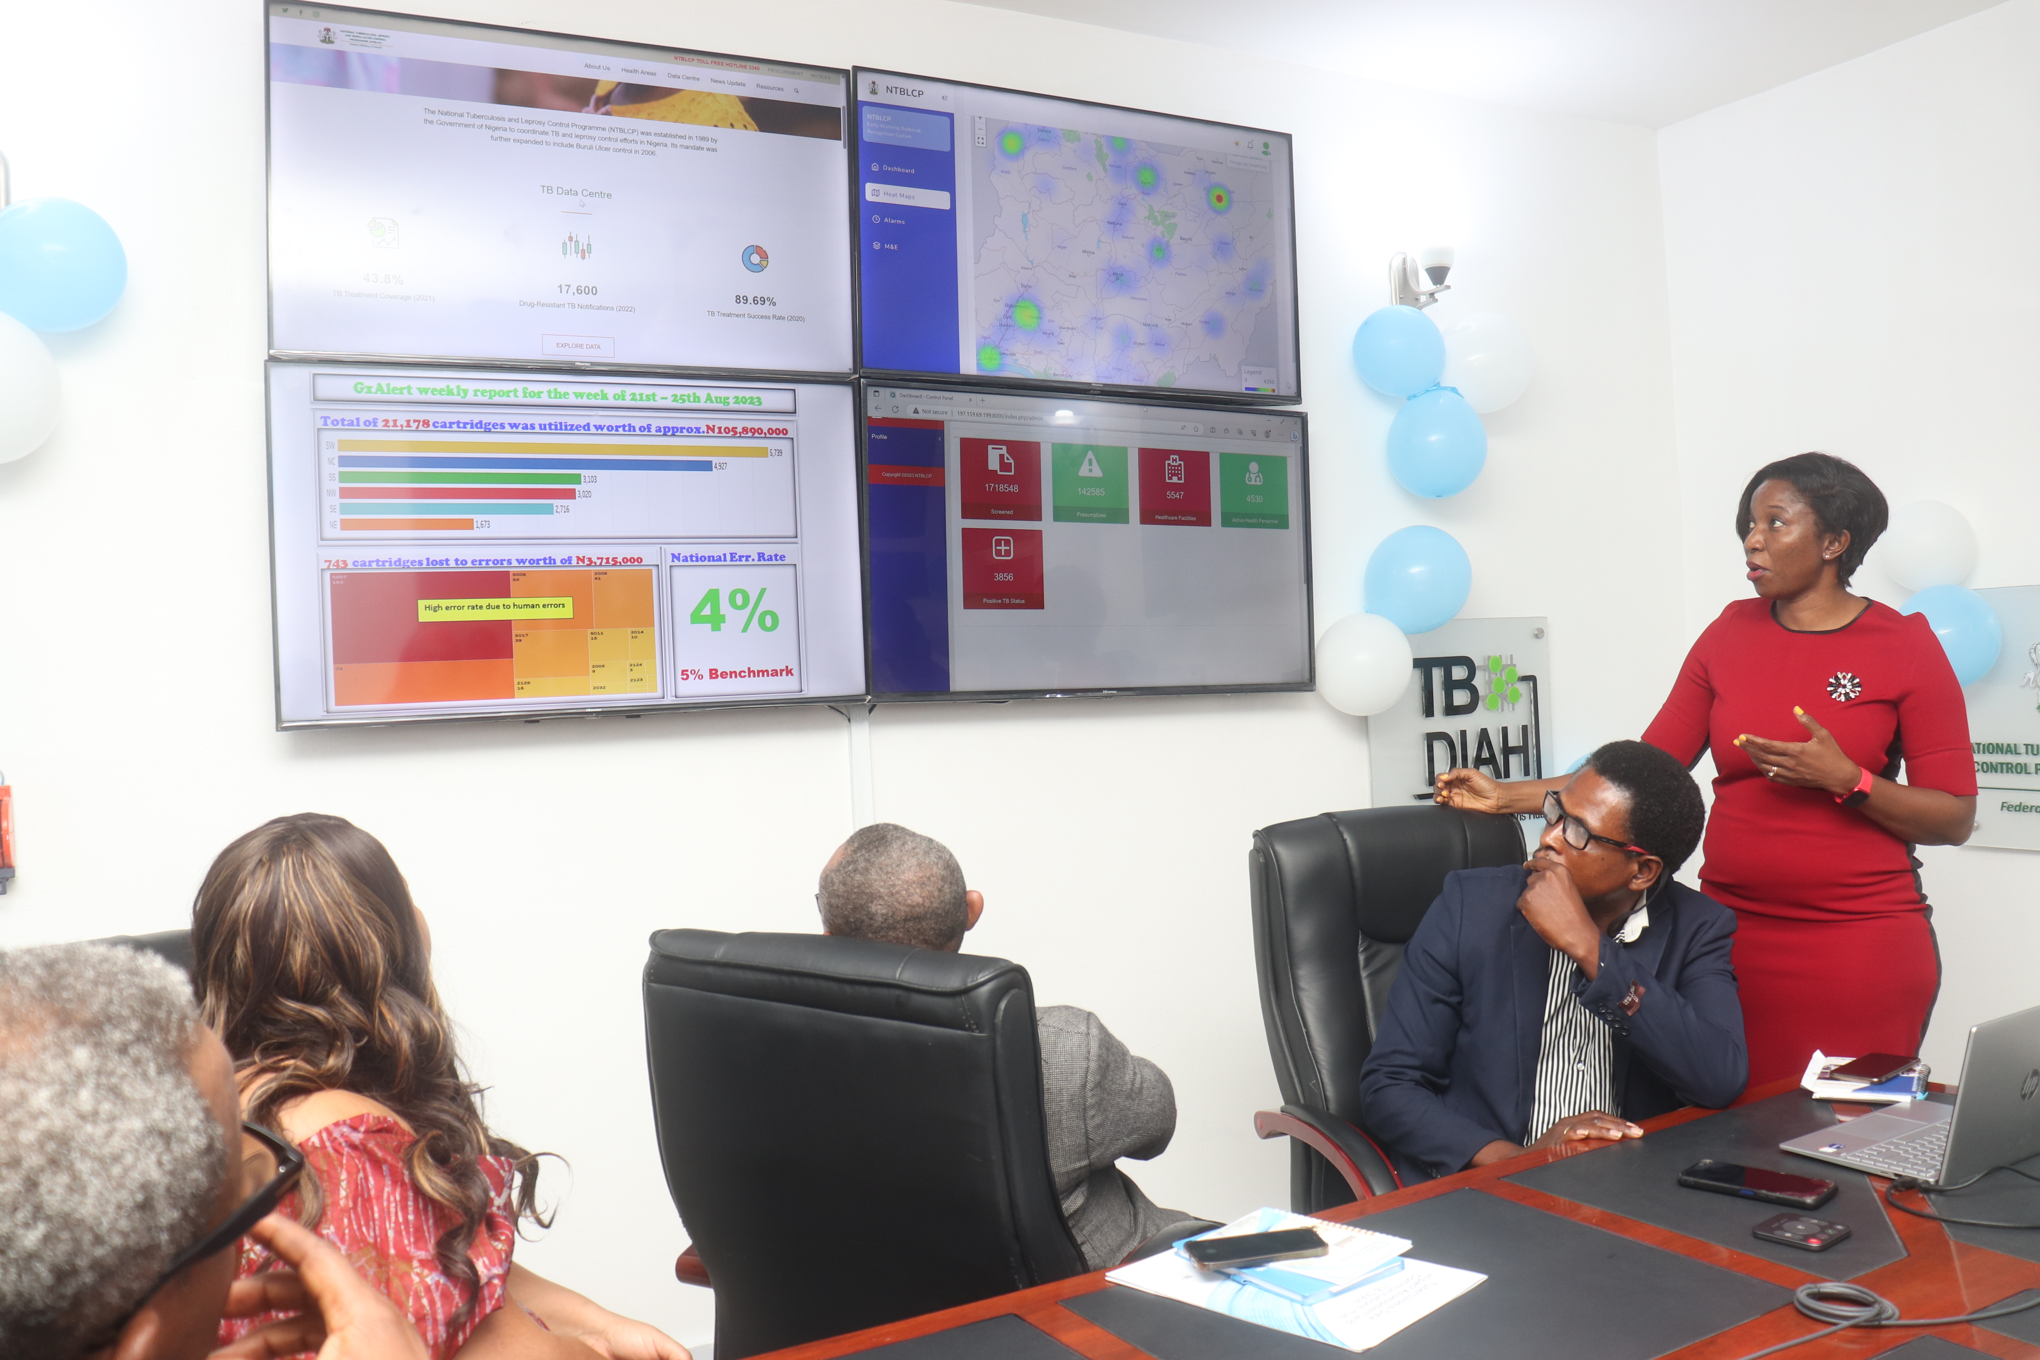
Approach
Needs Assessment
SOP Development
Launching
01
03
05
02
04
TB Situation Room
Procurement and installation of equipment
Capacity Building
TB Situation Room: Data sharing platform, enables the display of information in dashboards, enhance data use and decisions making to improve the quality of TB services.

Slide 6
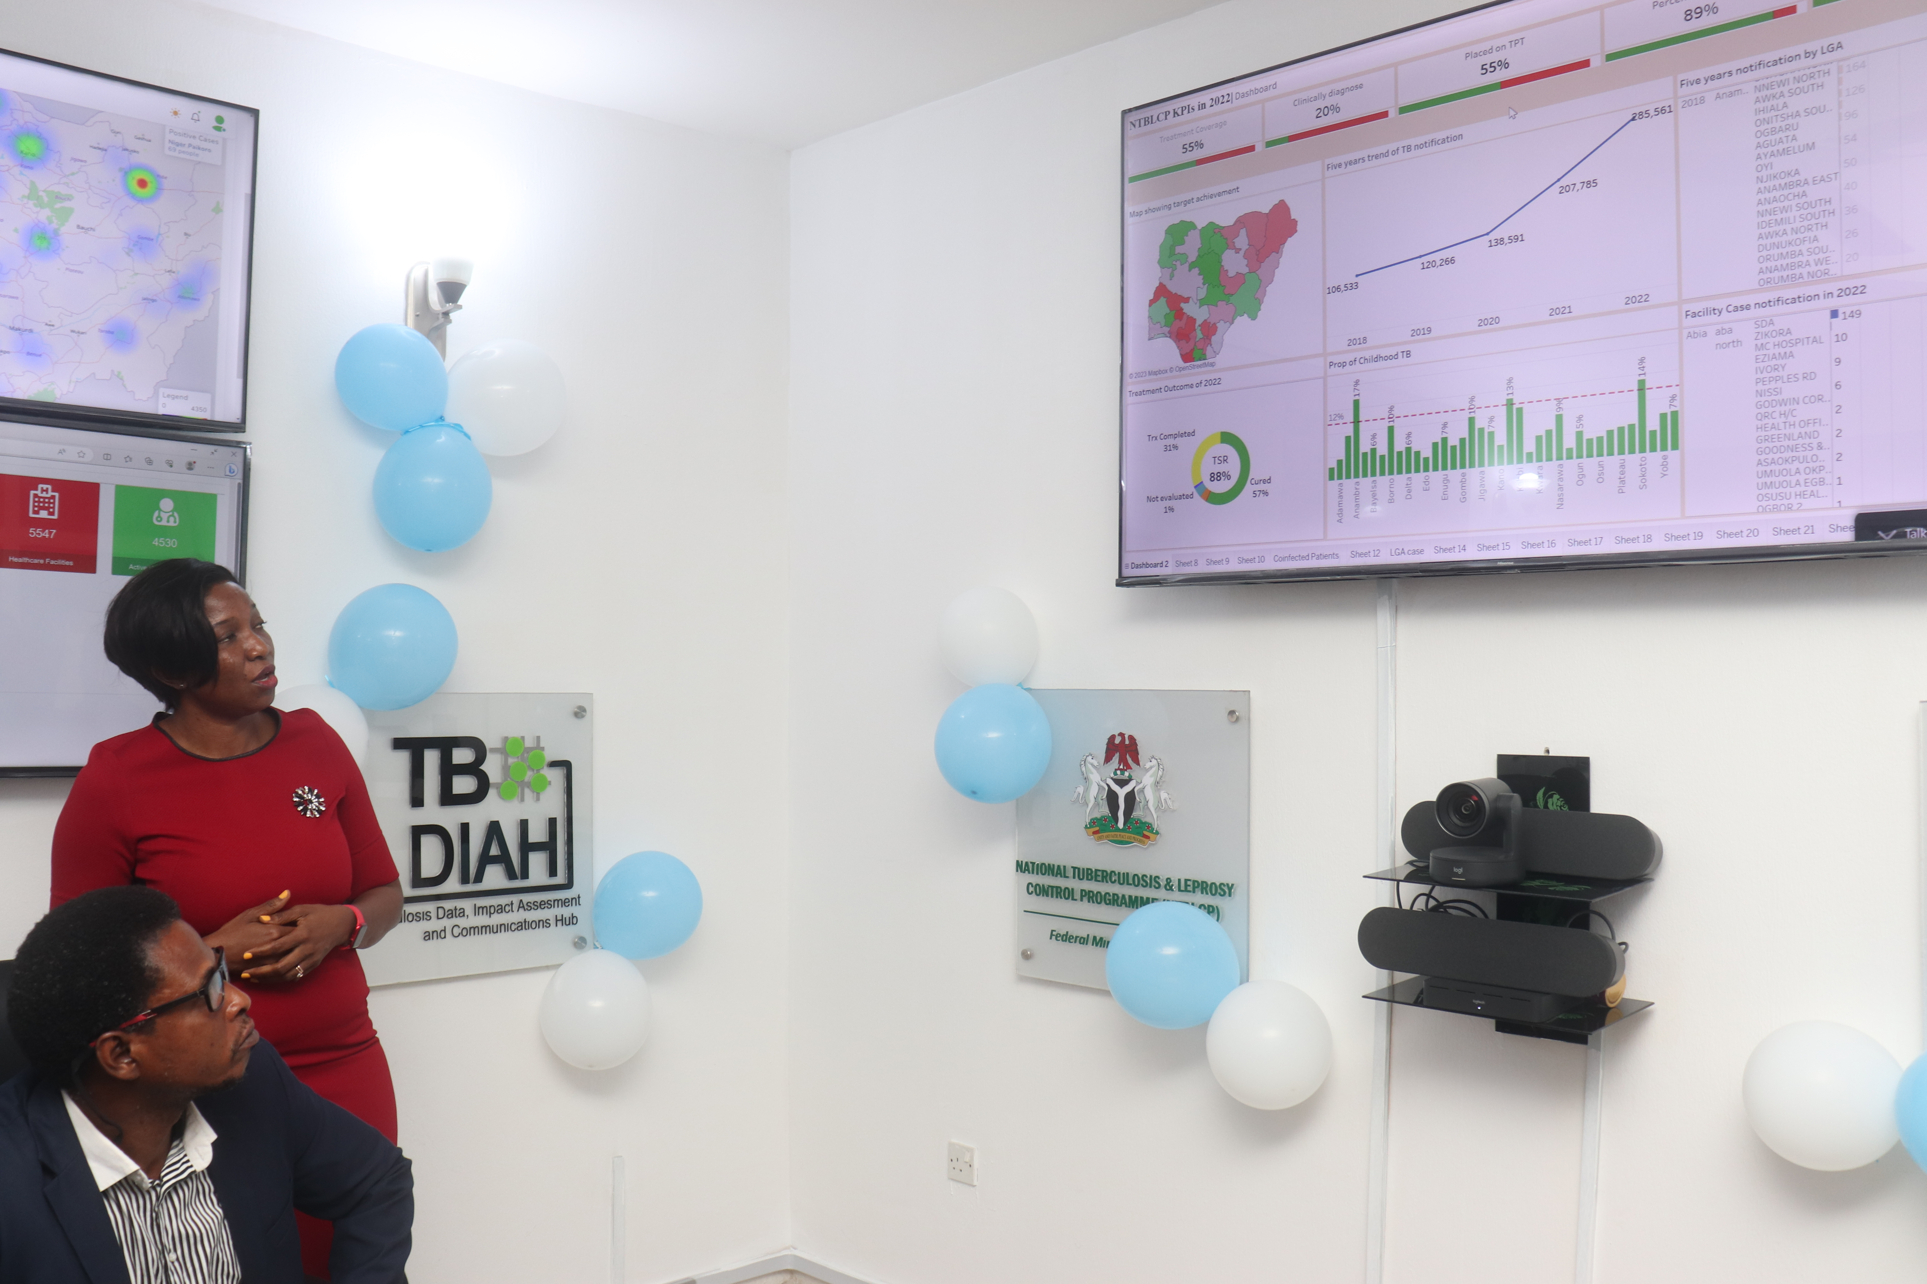
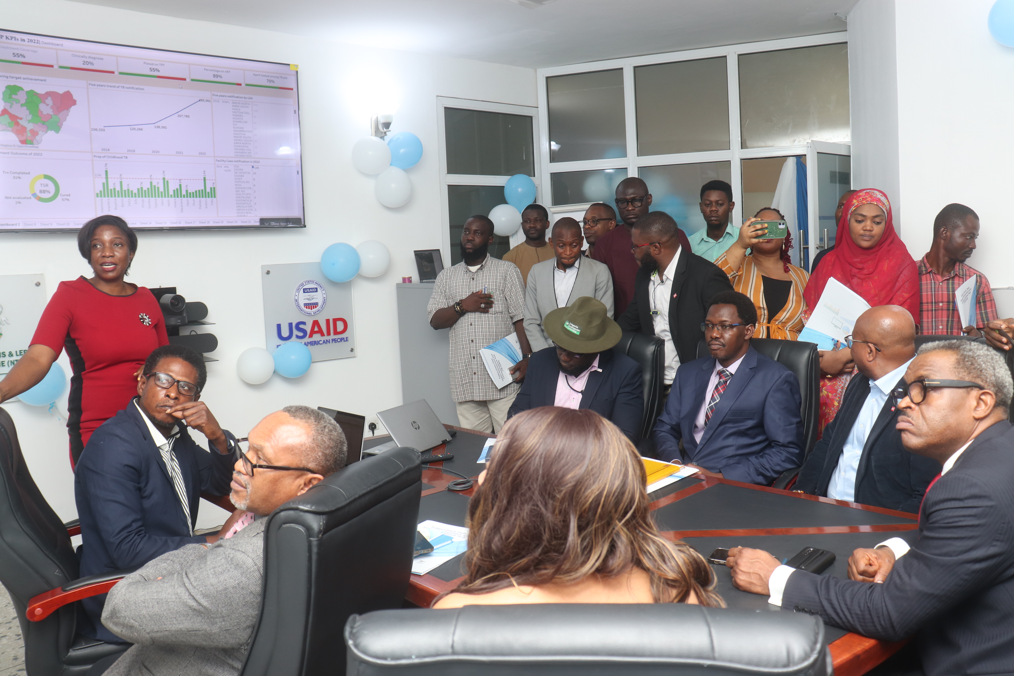
Results and Opportunities
Gains of TBSR
Strengthen the analysis, interpretation, and presentation of TB data to monitor the performance of program interventions in the NTBLCP
Empower stakeholders across different levels of TB programming to use data to achieve the targets of the national strategic plan or program interventions.
Integrate data originating from numerous national data sources, especially program-level data, including service statistics, drug management system, laboratory information system, human resources, and other data that are available in a “one-stop” dashboard.
Web and Electronic App Dashboards:
MATS, EWORS, NTBLCP website
NTBLCP Tableau Dashboard

Slide 7
Its serving its purpose
Access to real-time or near real-time data
Multi- layered data review and analysis
Data visualization
Collaboration and communication tools:
Data security and privacy

Slide 8
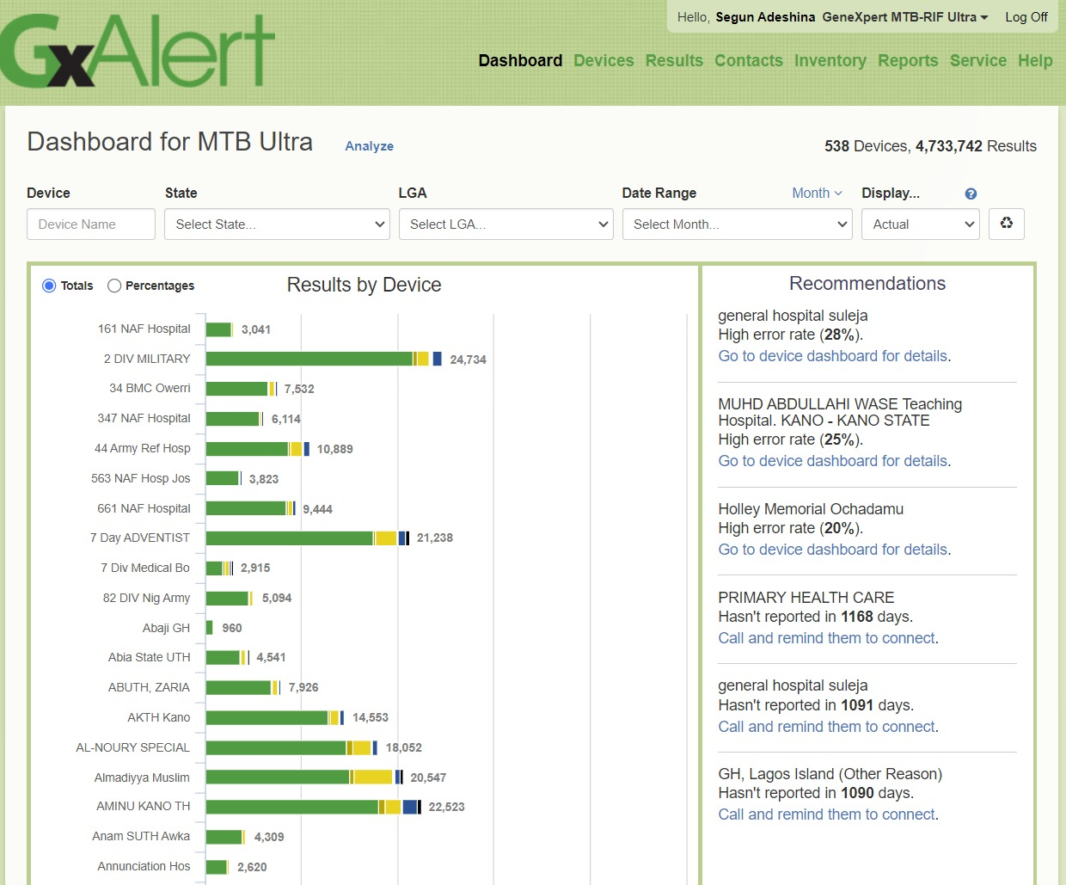
Access to real-time or near real-time data
Logistics
MATS
PPM Dashboard
Leprosy and Buruli Ulcer

Slide 9
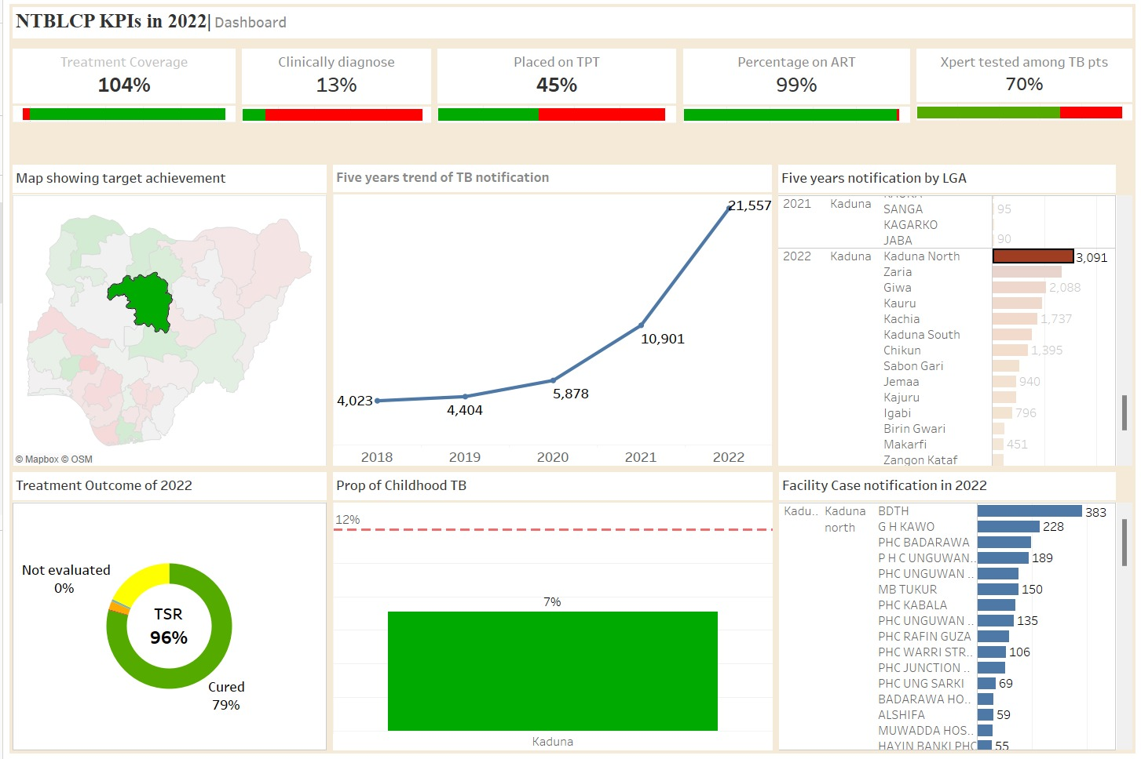
Multi- layered data review and analysis

Slide 10
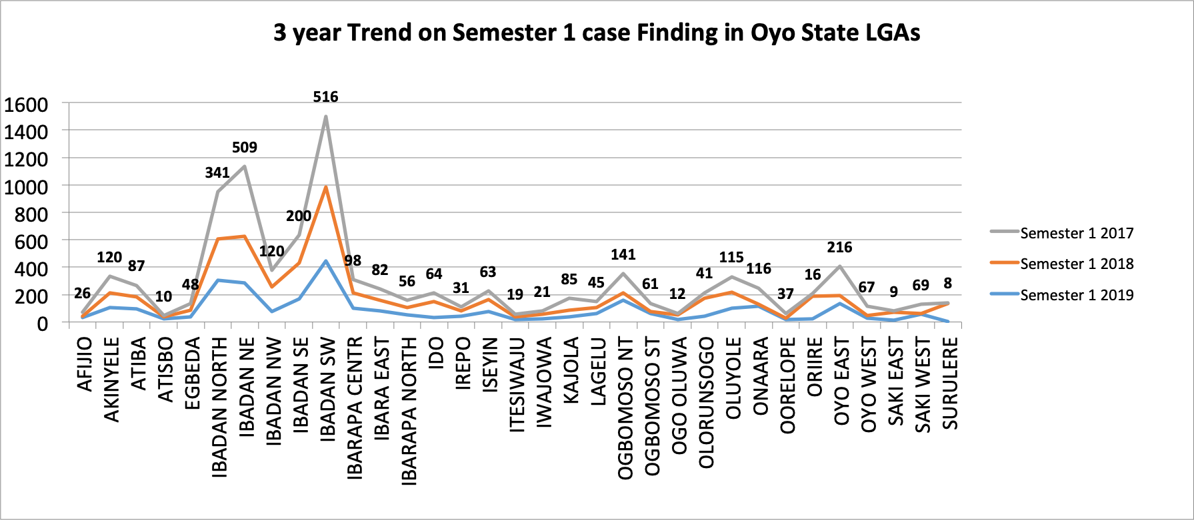
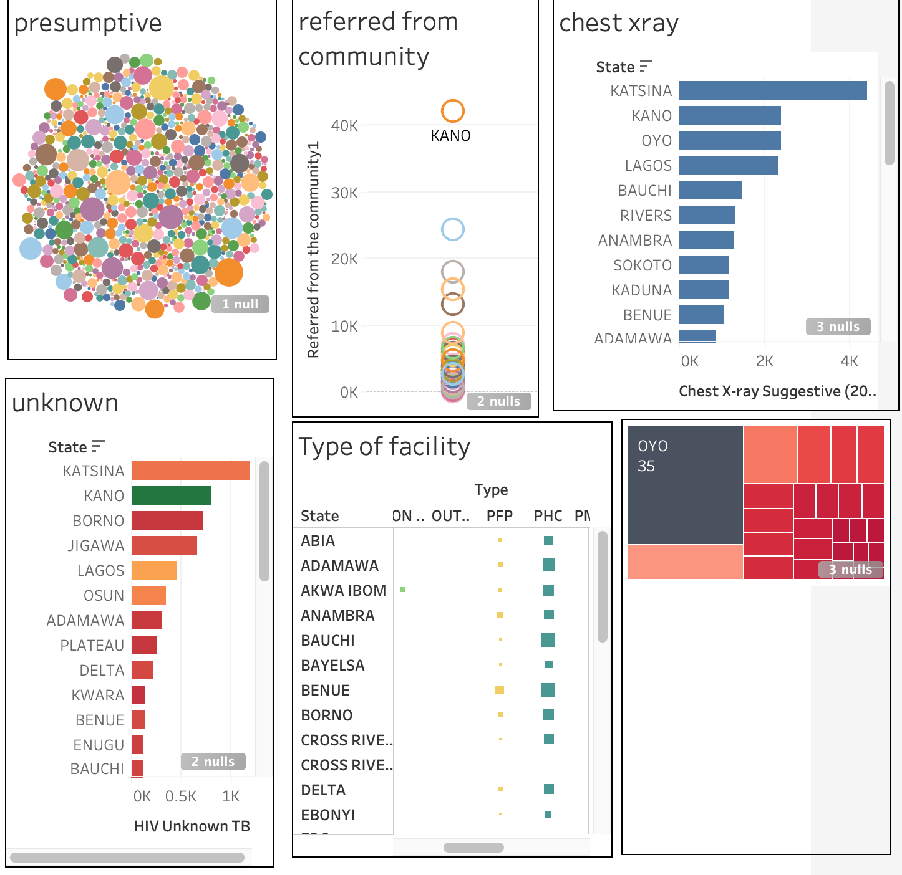
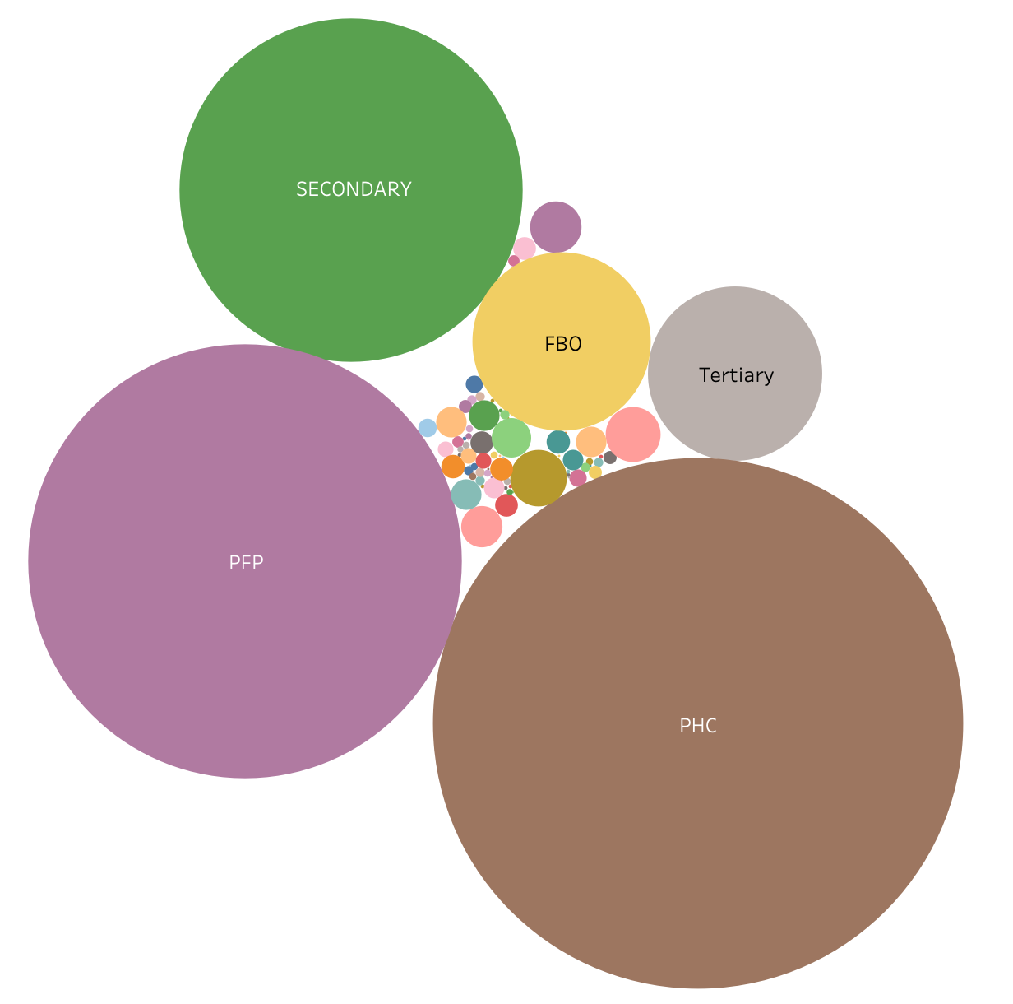
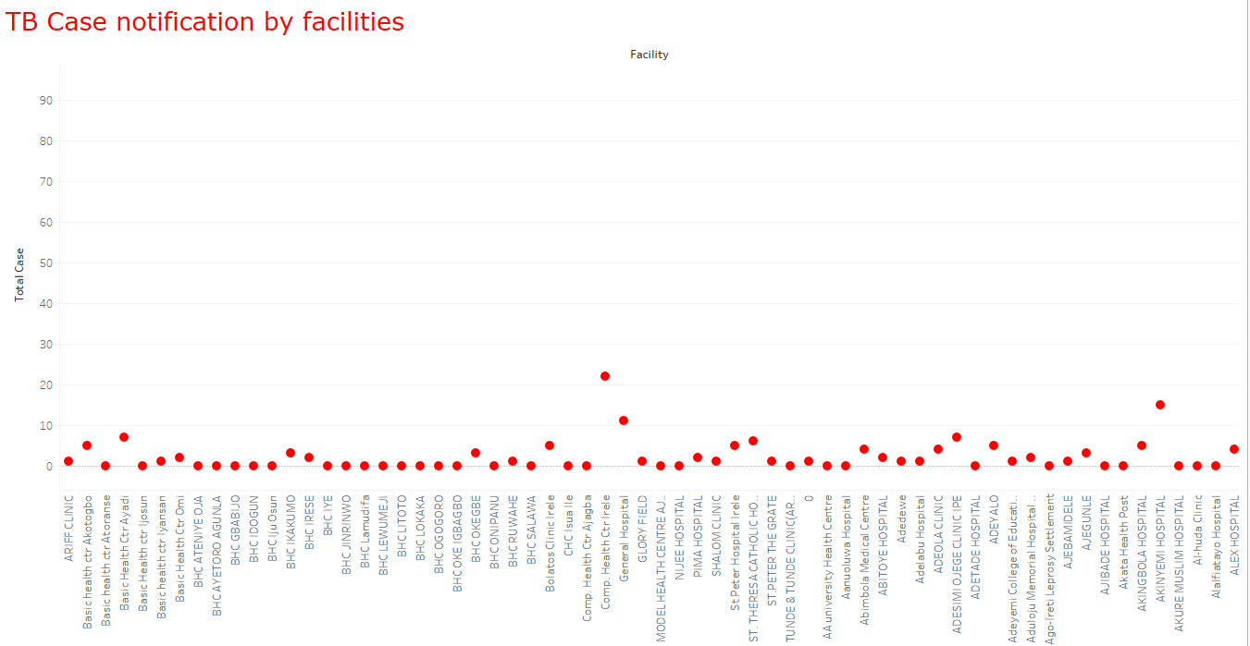
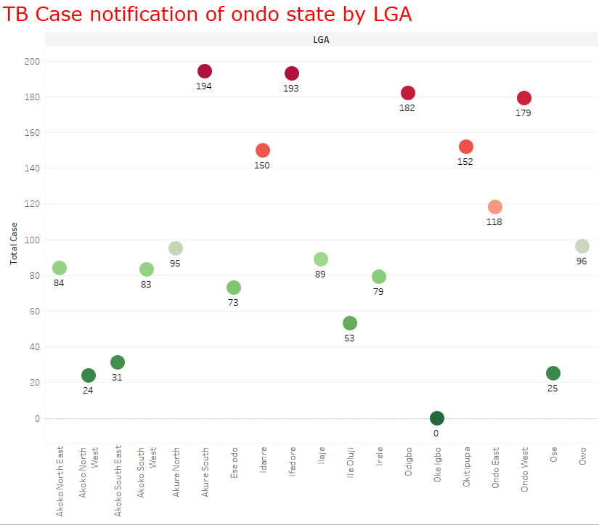
Data visualization

Slide 11
Collaboration and communication tools
The DRS Data Tele-conference room
Data clerks and manager resumes here
Validation of each entry
Tele-connect for any flagged site
Everyone views the flagged entry
Corrections real-time
PDX
Big data issue;
Data view for target state identification before visit
Mid-field meetings for

Slide 12
THANK YOU

