Slide 1
Africa Regional Workshop on Strengthening TB Monitoring and Evaluation Systems
16-19 April, 2024 • Dar es Salaam, Tanzania
NTP UPDATES: UGANDA
Logo
Logo

Slide 2
Uganda’s TB Profile and TB Situation Snapshot

Slide 3
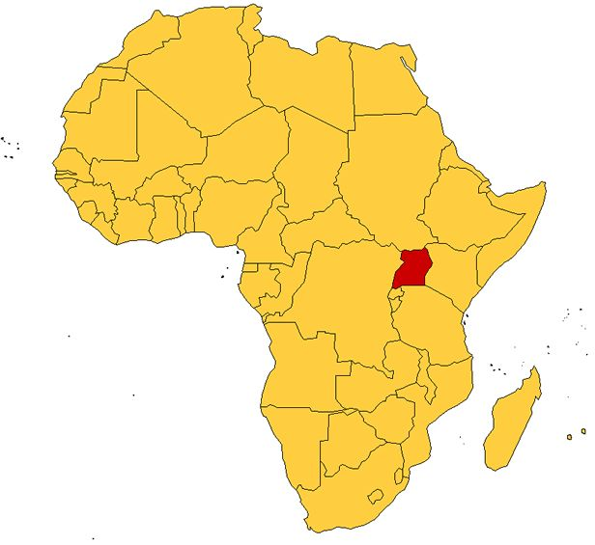
Uganda
Uganda among the 30 high burden TB & TB-HIV countries
Estimated population in 2022 at about 47 million*.
Estimated incident cases at about 94,000 TB cases (15,000 0-14yrs)*.
The national 2014/2015 prevalence survey revealed TB burden in Uganda was 253/100,000 population
Incidence 198/100,000 population, 240 new TB cases occur daily*
MDR TB incidence stands at 3/100,000 Population
TB death rate at 9.9 per 100,000
70% diagnosed with WHO-Recommended Rapid Diagnostic*.
*Global TB report 2023

Slide 4
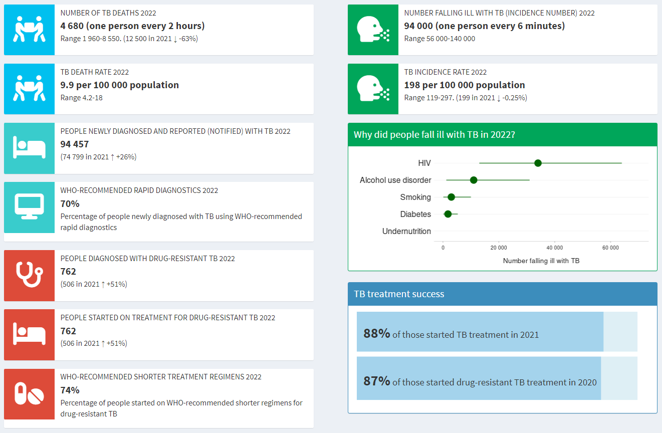
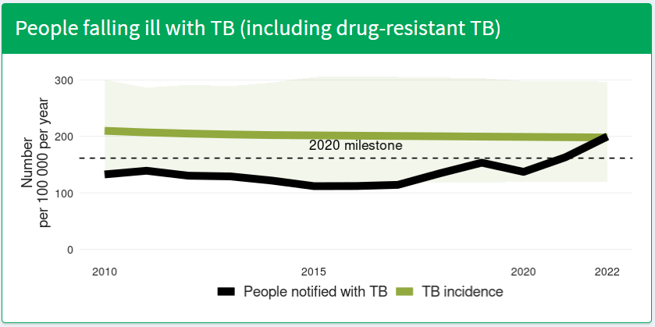
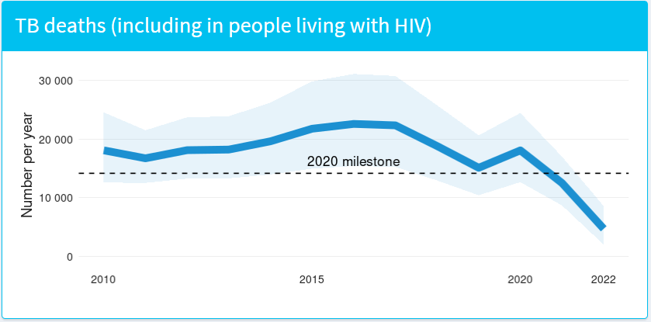
Uganda TB profile
Source: WHO TB country profiles

Slide 5
Data-Driven Strategies: Update on national TB M&E, surveillance, and data use

Slide 6
Strategies in place for effectively using national TB data
Annual Stakeholders Conference
Annual World TB Day Scientific Symposium
National Coordination Committee for TB (Every Qtr)
NTLP Quarterly Performance Review Meeting
Data Harmonization Meetings (1st Week of the Qtr)
NTLP Weekly Planning Meetings (Every Monday)
Weekly epidemiological outlook, hot spots & outliers
Implementing Partner TB performance review meetings
DHIS2 Dashboards, Power BI PIRS (SURGE Dashboard)
National Level (Qtrly)
Regional Level (Qtr)
District Level (Wkly ,Mtly, Qtrly)

Slide 7
Commitment to mainstream TB across MDAs
This ensures TB Data Demand
and Information use
in Advocacy, planning, forecasting
policy formulation
and transformation

Slide 8
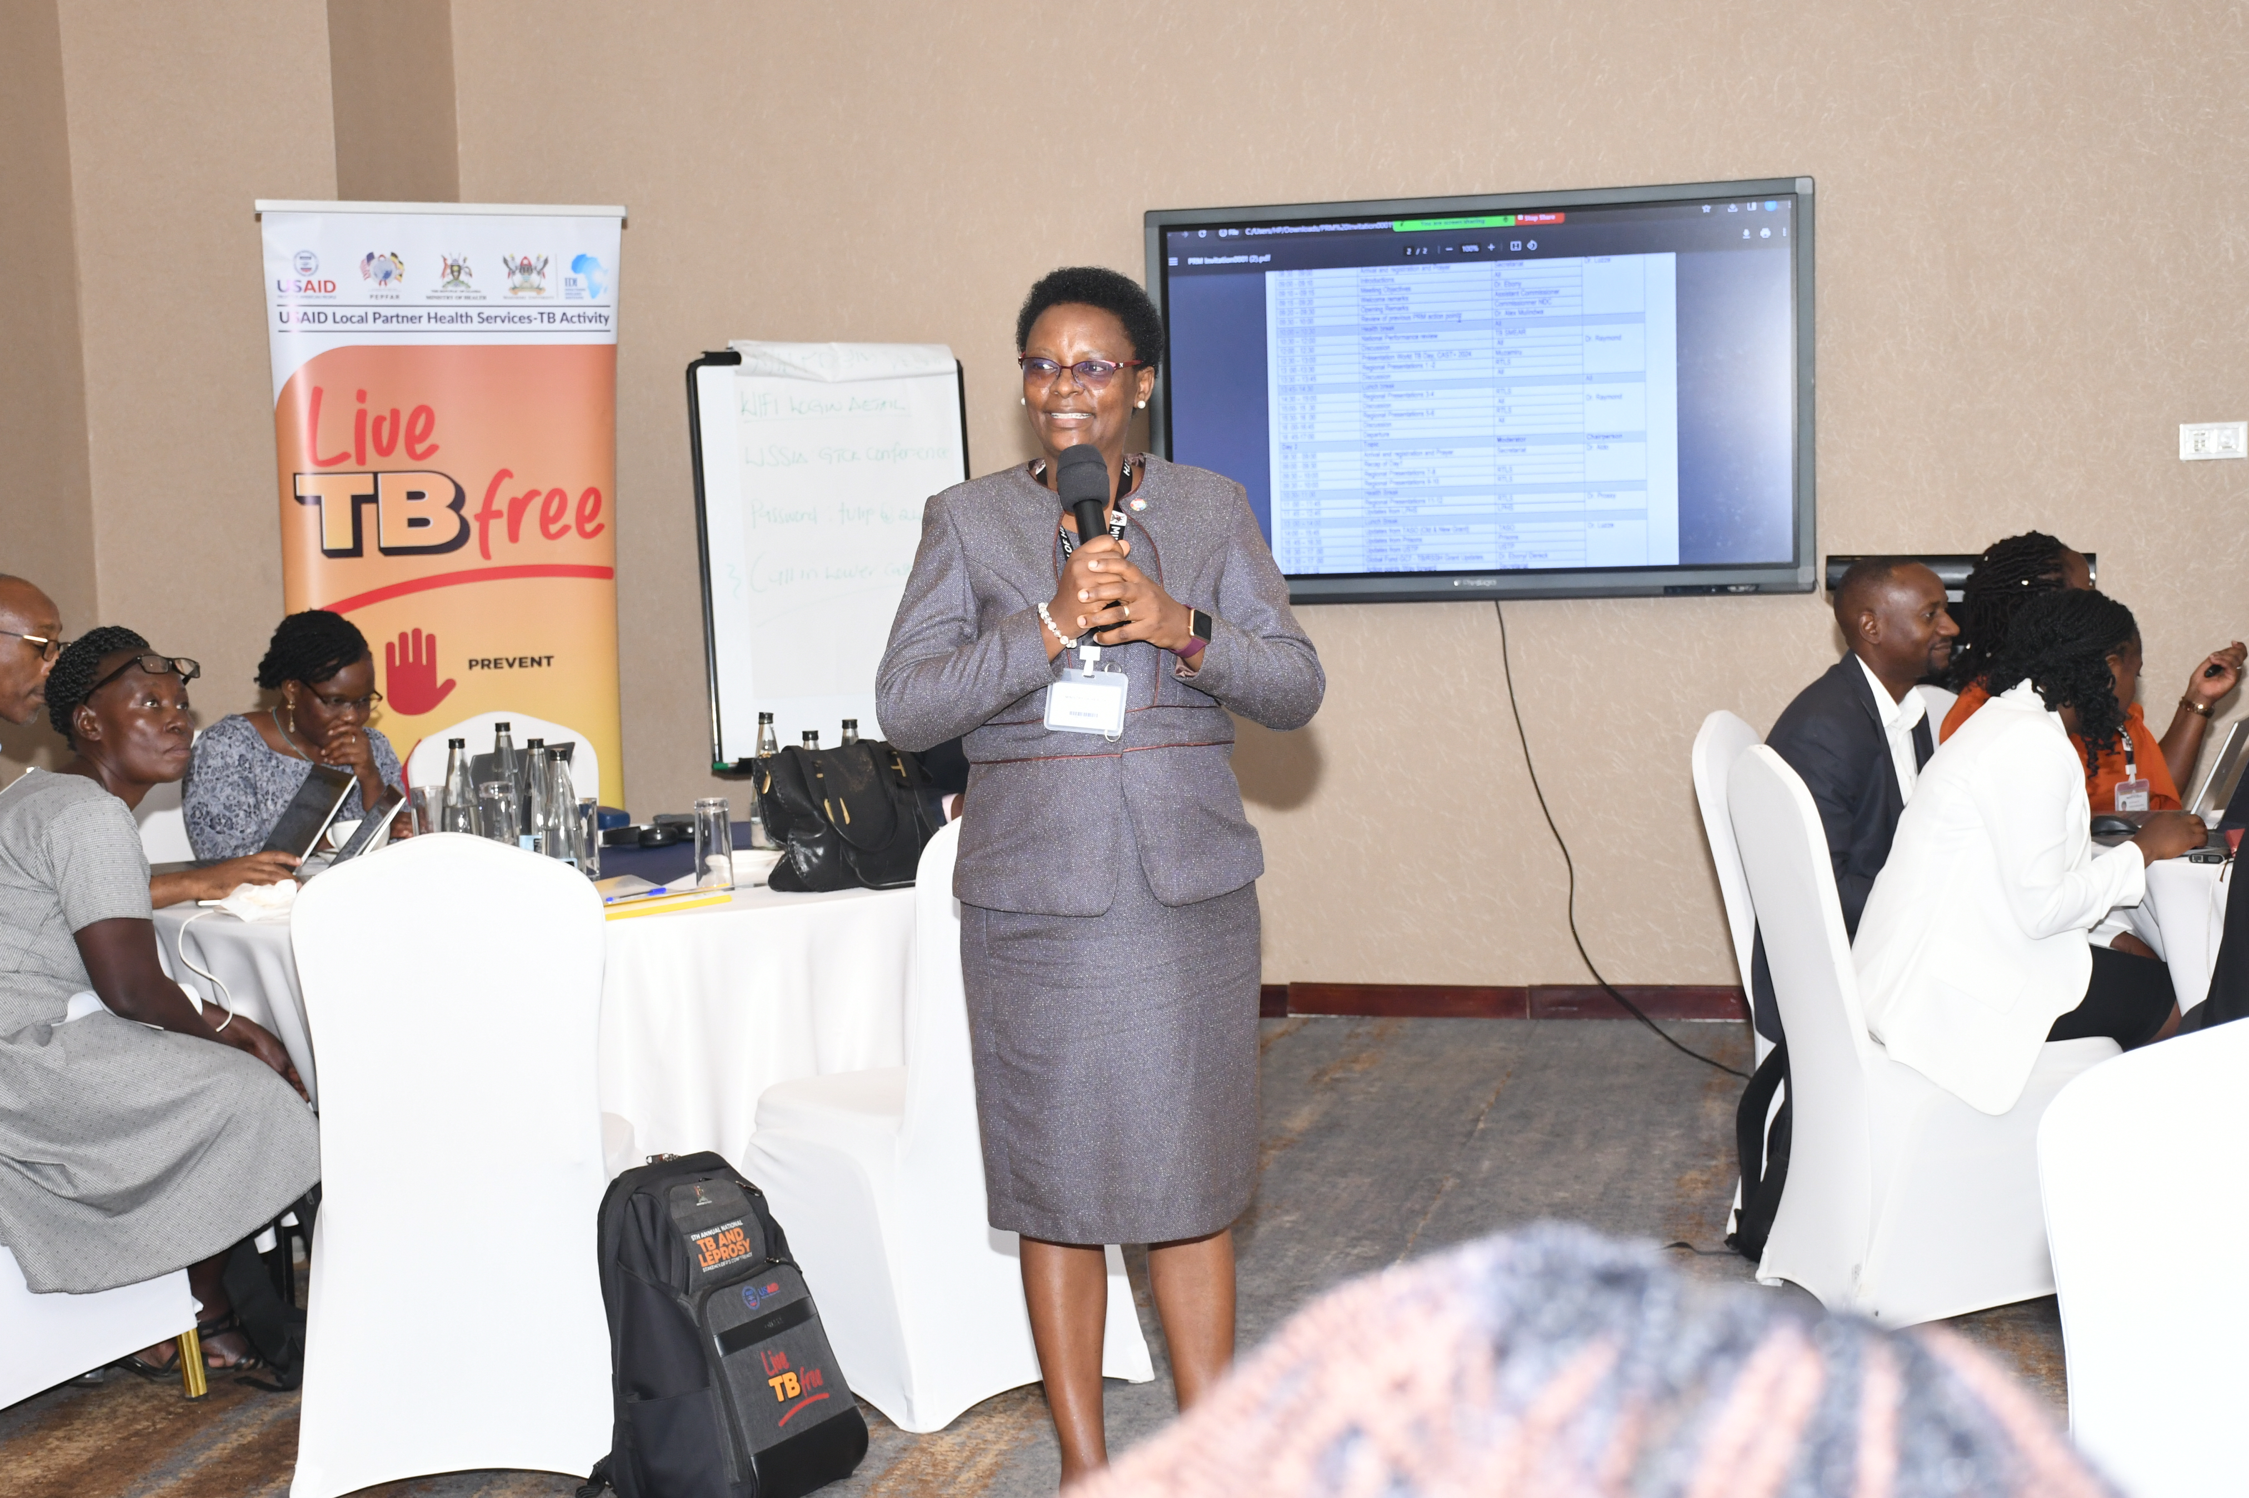
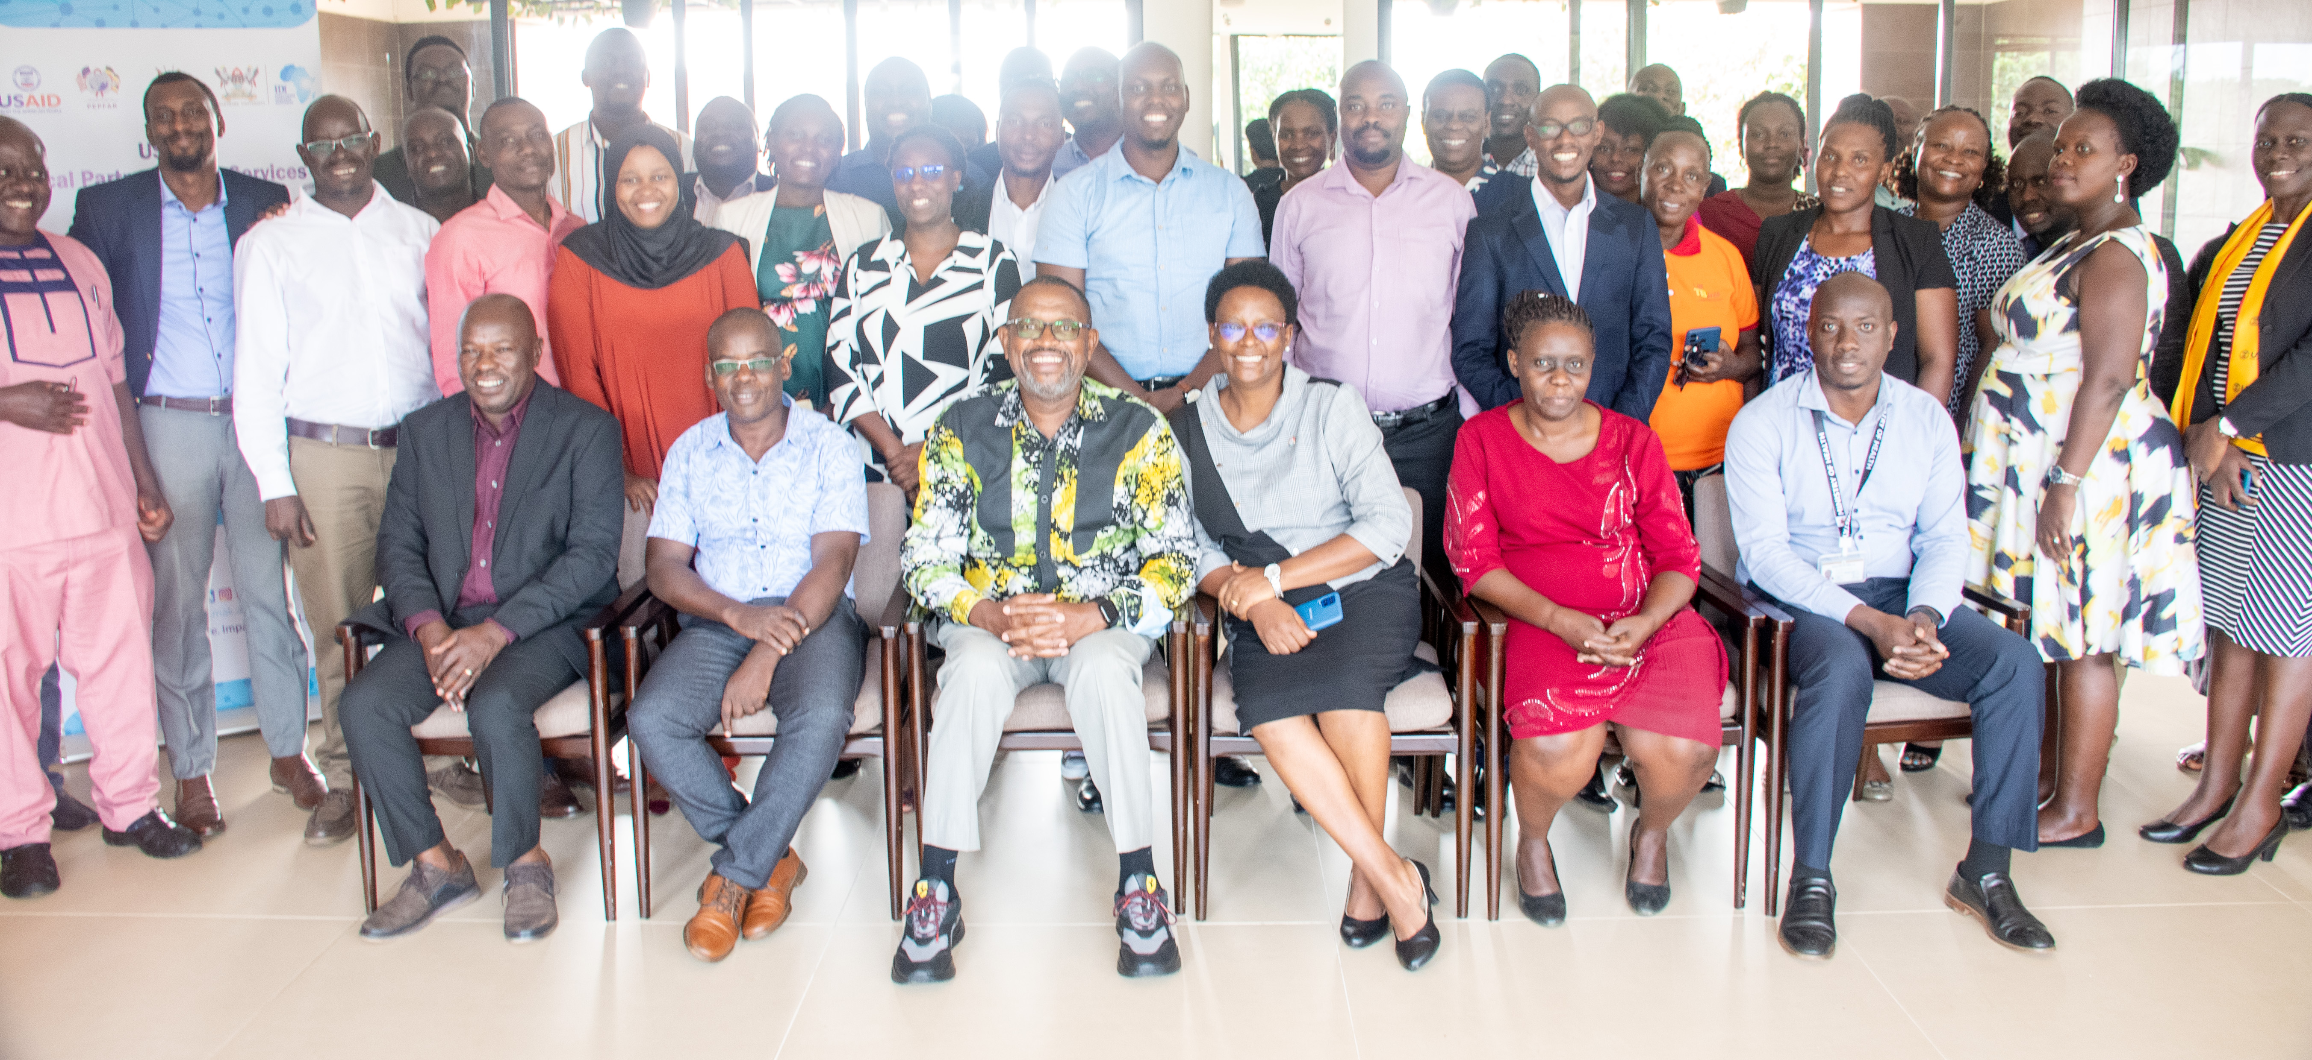
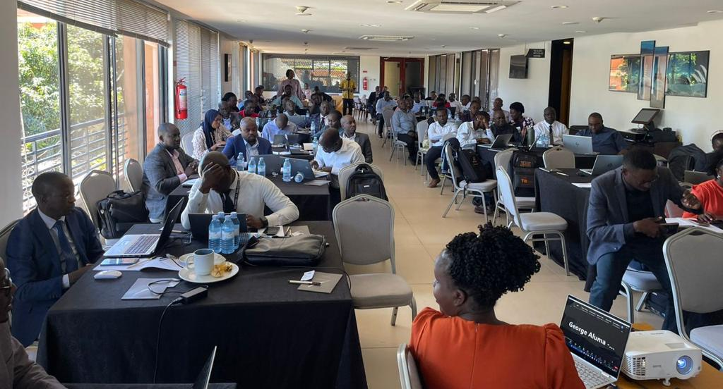
Gallery
Annual Science Summit 2023 (400 Abstracts)
Quarterly Performance Review Meetings

Slide 9
Recent improvements to the National TB M&E system
DHIS2 Upgrade (version 2.37.7.1) - with enhanced Visualization features
Electronic Case based Surveillance System for TB and Leprosy (eCBSS) - Patient Level Data Analysis
HMIS Tools Revision – Including changes in dissagregations and TB Management e.g BPaL/BPaLM
Labxpert DS – Pick information right from the Machine, reduces errors, Improves Linkage
Pharmacovigilance System (PVMS) to monitor aDSM (Adverse TB Drug safety monitoring and management)
Systems for monitoring TB community interventions (TBInfo, TBMIS)

Slide 10
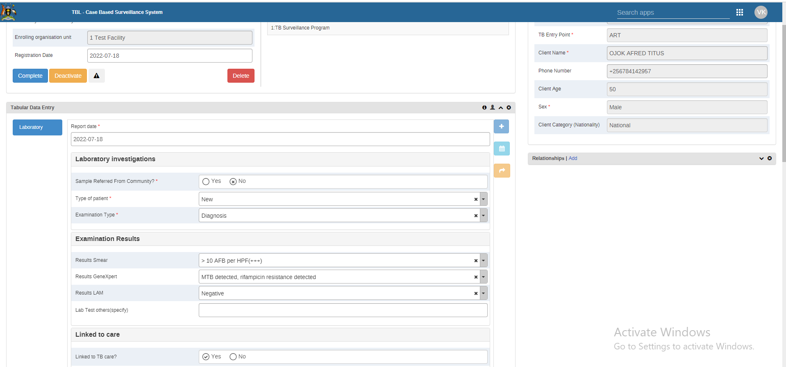
Successful data-driven initiatives;
Patient is Screened for TB using ICF Guide
eCBSS Integration into routine Patient Management
Patient Notifications /Reminders by SMS
Cohort reviews for MDR/RR-TB patients
Routine data quality monitoring at National, sub-national & facility level
Presumed cases sent to the Lab for Confirmation
Contact tracing completed for further linkage
Appointment Lists generated to ensure treatment completion
.
.
.
.
.
.
.
MTB+ & RR Cases entered in eCBSS
Cases Appear on Sites Dashboard and Notification is sent to TB FP
Follow-up calls made to DTUs and Patients for Initiation
RTLs generate Line Lists of RR patients and compare with Registers

Slide 11
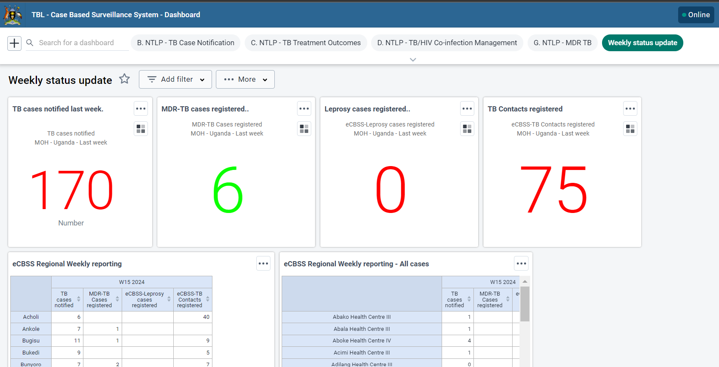
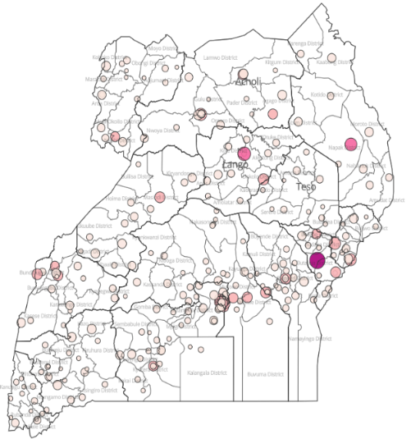
Dashboards
eCBSS
LABXPERT
System
helps in
sending
notification
to Rif. Res
Cases
CAST-TB
DHIS2
Platform
Community (Household)interventions through CAST (4 Day), Integration with other services MCH, WASH, Malaria, HIV

Slide 12
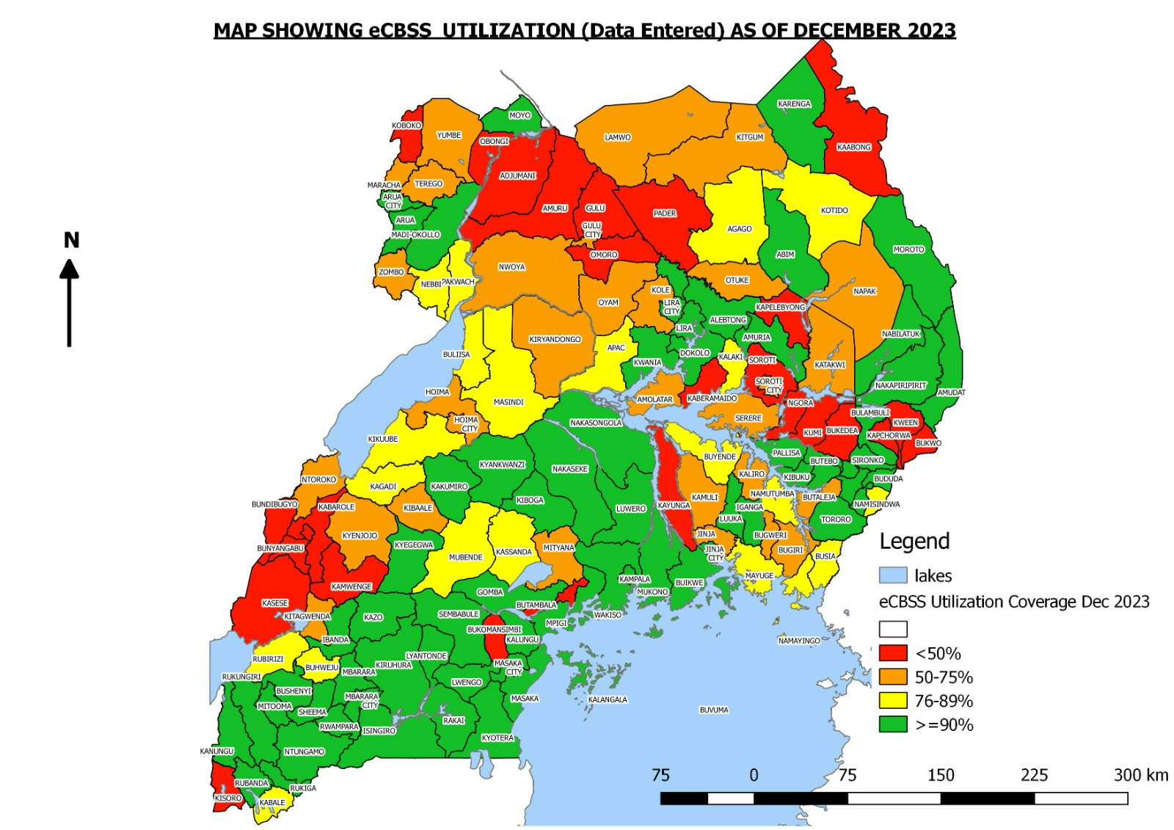
Case level data(eCBSS) Coverage and Utilization
A Summary is shared out Weekly
to track trainings DS/ DR TB notifications
DTUs that have entered data in eCBSS | 975
Utilization | 79%

Slide 13
Weekly Monitoring of patient level data entry (Coverage at 73%)

Slide 14
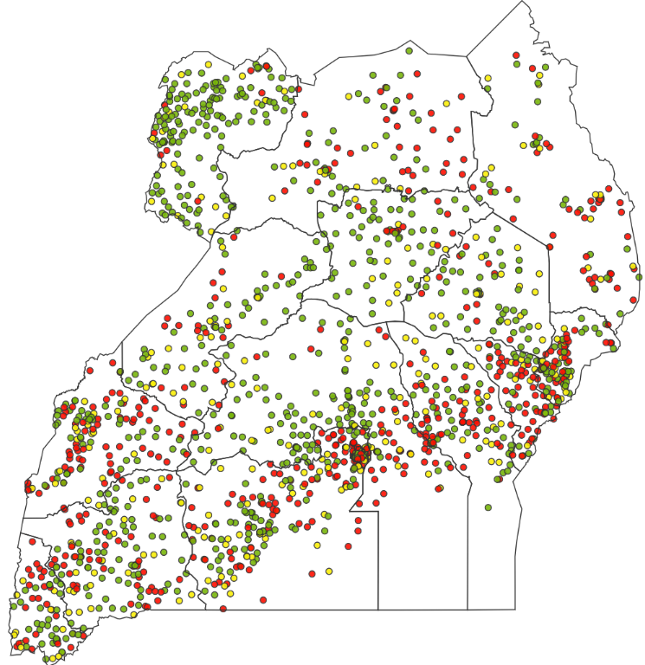
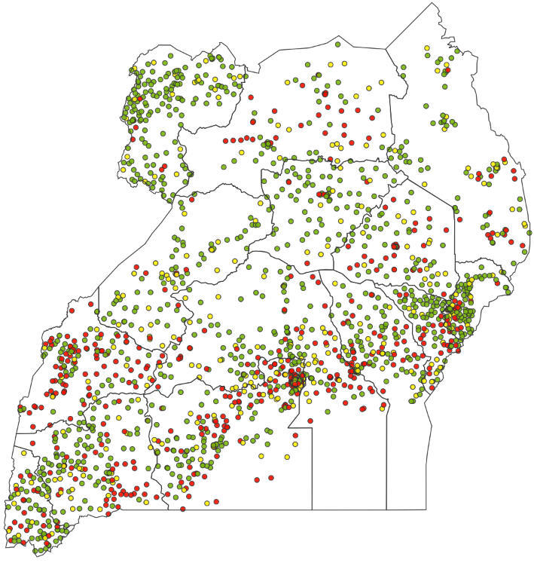
Challenges in TB data management & potential solutions
Haphazard, sporadic data quality Issues due to staff turnovers, indicator understanding
Targeted interventions, Manuals, Guidelines, trainings, webinars
Jul – Sep 2023
Changing Trajectory every Qtr
Oct - Dec 2023
Number Accessed a Genexpert
 | Under reported <-2% or > 2%
 | Well reported 0% Variance
 | Over reported <-2% or > 2%
 | Error (<5% or >5%)

Slide 15
Upcoming plans for data-driven TB control in Uganda
Interoperability of different systems
eCBSS Scale up targeting 100% coverage
Leveraging eCBSS as a data mine – big data
Venture into Artificial Intelligence and Machine Language with already existing systems
Use innovative ways to do modelling and studies e.g CAST+ Prevalence
Prevalence Survey with Sub-National (MDR/RR-TB and DS-TB)
Leveraging existing data (from researches, DHS, surveys) – already ongoing with previous LQAS data)
TB Operations Research support (e.g integrating x-ray screening in the screening algorithm, analysis of routine data for manuscipts)

Slide 16
TB M&E Beyond Numbers: Understanding trends in PBMEF core indicators

Slide 17
Notifications per year

Slide 18
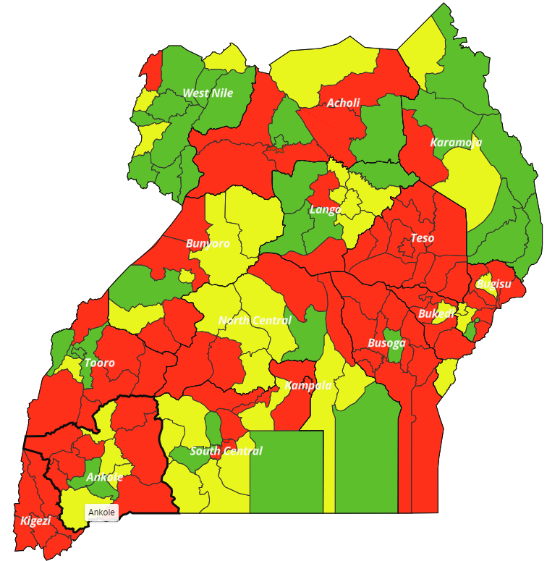
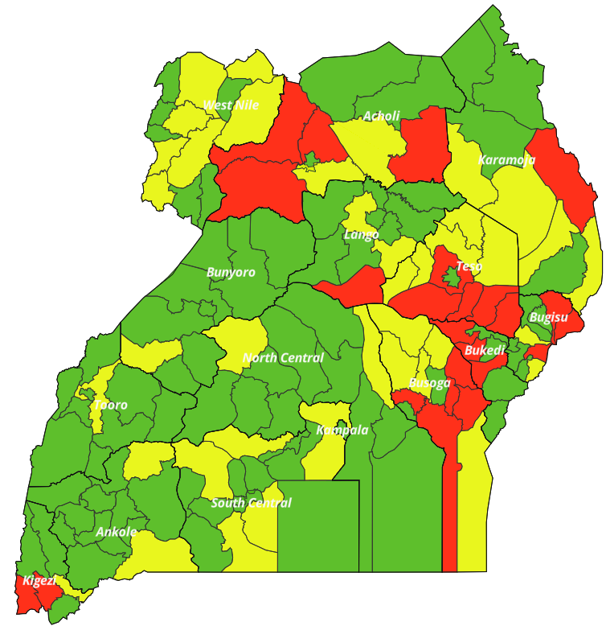
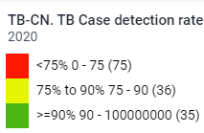
Treatment Coverage by District 2020 - 2023
2020
2023

Slide 19
DS-TB Treatment Success Rate

Slide 20
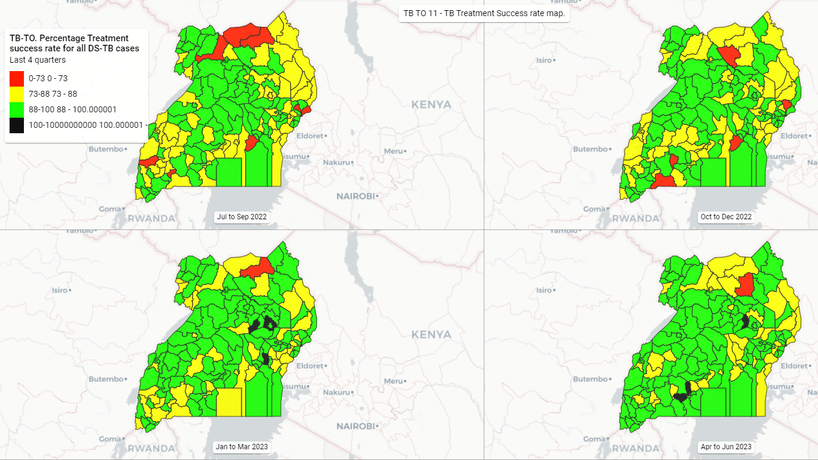
Treatment Success 2022/23

Slide 21
RR/MDR TB Notifications

Slide 22
