Slide 1
Africa Regional Workshop on Strengthening TB Monitoring and Evaluation Systems
16-19 April, 2024 • Dar es Salaam, Tanzania
NTP UPDATES: {Kenya}
Logo
Logo

Slide 2
Country TB Profile and TB Situation Snapshot

Slide 3
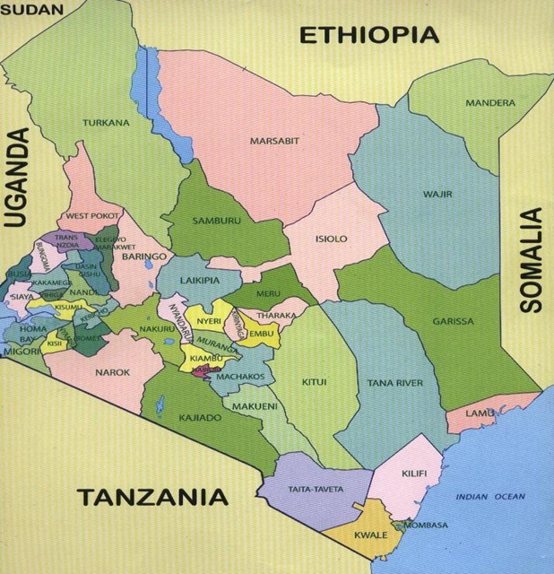
Context –Background
Counties 47, Sub-counties 256 with 301 TB control zones
Population | 54 million
 | Total | Private
Total no. of health facilities | 15,000 | 48%
Number of TB treatment sites | 4,500 | 27.2%
Number of microscopy diagnostic sites | 2,700 | 7.8%
Central culture and molecular labs | 5 | 0%
Digital chest x-ray | 130 | *
mWRD | 304 | 16%

Slide 4
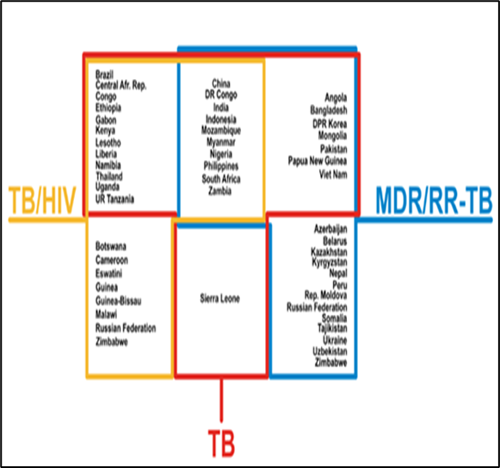
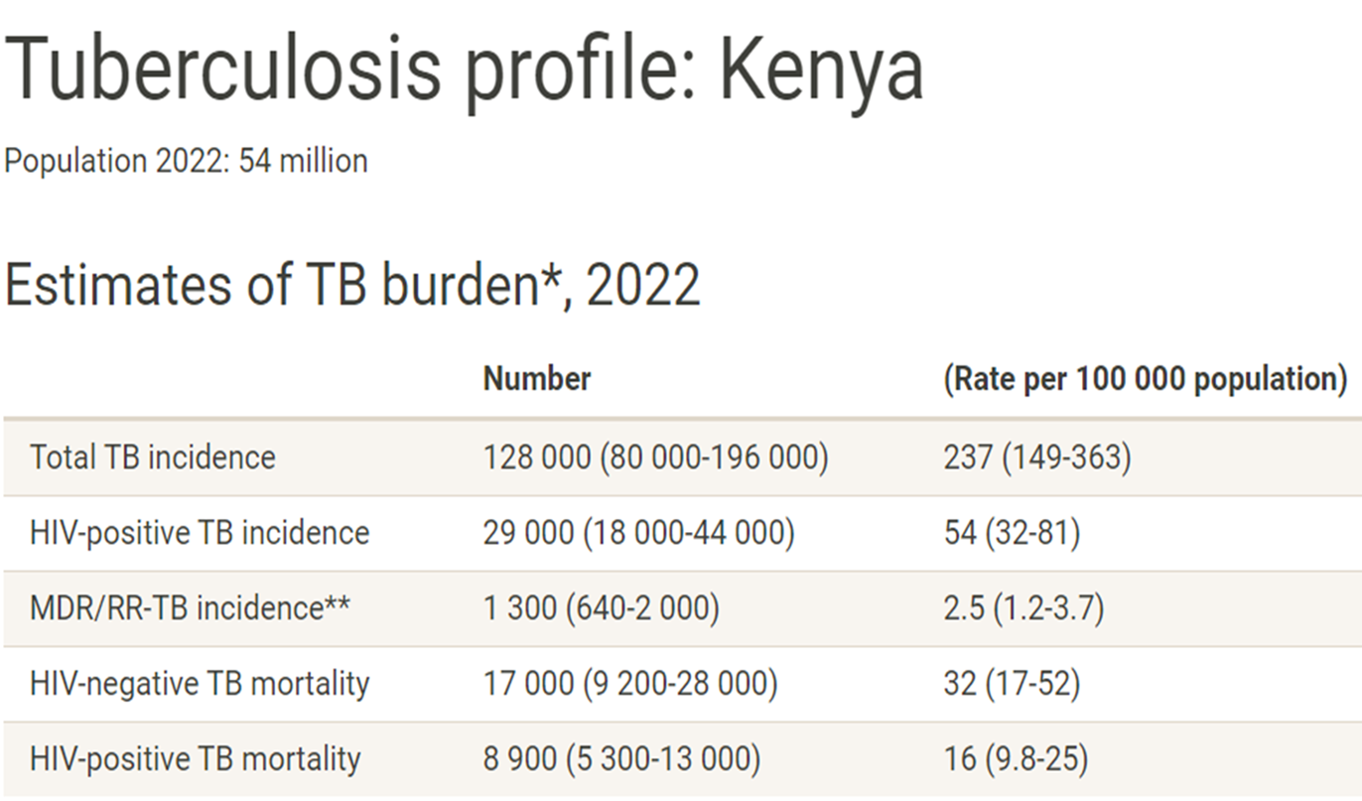
Context –Kenya TB Burden

Slide 5
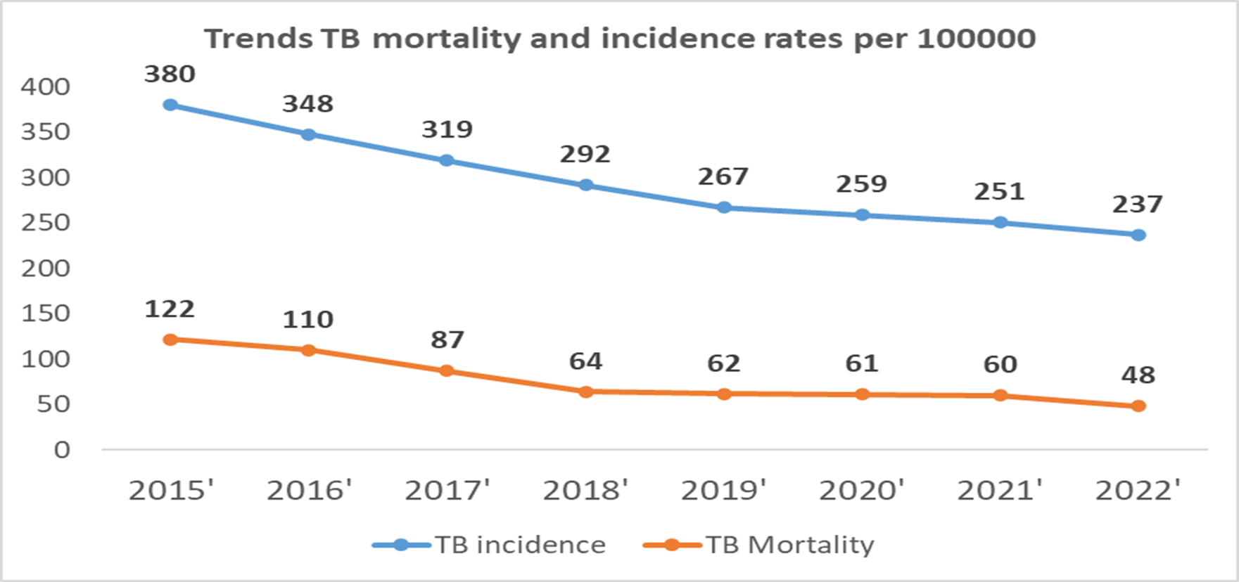
Impact progress: Incidence & mortality trends

Slide 6
Data-Driven Strategies: Update on national TB M&E, surveillance, and data use

Slide 7
Strategies for effective TB data use
NSP M&E plan with comprehensive indicators with targets set at national level
Digitization of routine reporting for comprehensive and easy to use data collection; TIBU, T-bu lite for case based data collection at all levels
Standardization of reporting for ease of data analysis at all levels with national coverage
System integration; TIBU with KHIS2 , other data sources
Capacity building of health care workers at all levels on TB reporting and D4D
Data dissemination through timely annual reports, quarterly bulletins and now TIBU dashboards including PPM dashboards deployed in NTP website
Feedback mechanisms through routine data and performance reviews
Routine Data Quality Audits (DQAs)

Slide 8
Recent development and changes in M&E system
Introduction of t-bu lite at facility level; case based system
Availability of interactive data visualization dashboards in out TB surveillance system (TIBU) that includes PPM
Revision of M&E tools; new short term regimen for children and DR TB, new diagnostic tools
TIBU integration with labware and TIBULIMS
Revision and updating of TIBU architecture is currently on going
Availability of a MOH virtual Academy with TB data recording and reporting tools module

Slide 9
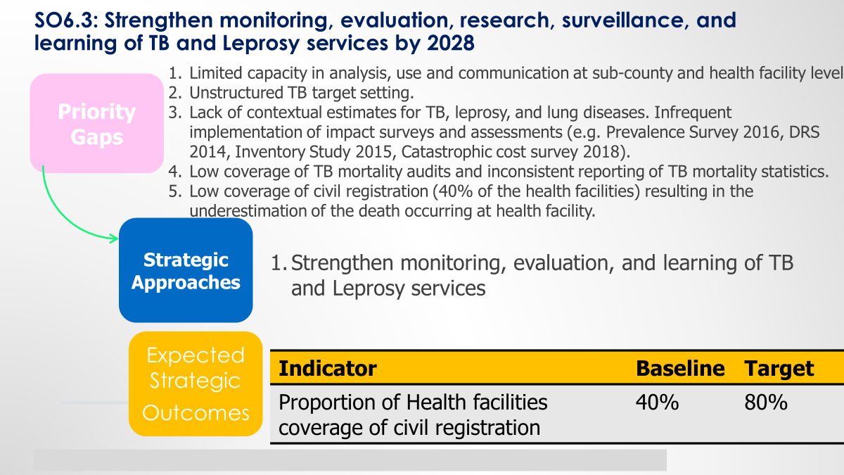
Common challenges in M&E system

Slide 10
Vision and Upcoming initiatives
With setting up of Kenya health digital agency; plans are under way to fully digitize health data with DHP
T-bu lite roll out to cover private facilities and also screening components at the community levels
Upgrading of TIBU architecture and scoping to include new developments in treatment and diagnosis
Revision of M&E tools in early 2025
Use of technology especially AI; to address challenges such as LFTU, PTLD
Studies plan; DRS survey, KAP, Inventory, Burden of TB among health care workers, Stigma index, patient cost survey and inventory study
Piloting of biometric patient identifier with GlobalID
Leveraging on the roll out of nation wide community health information system(e-CHIS)

Slide 11
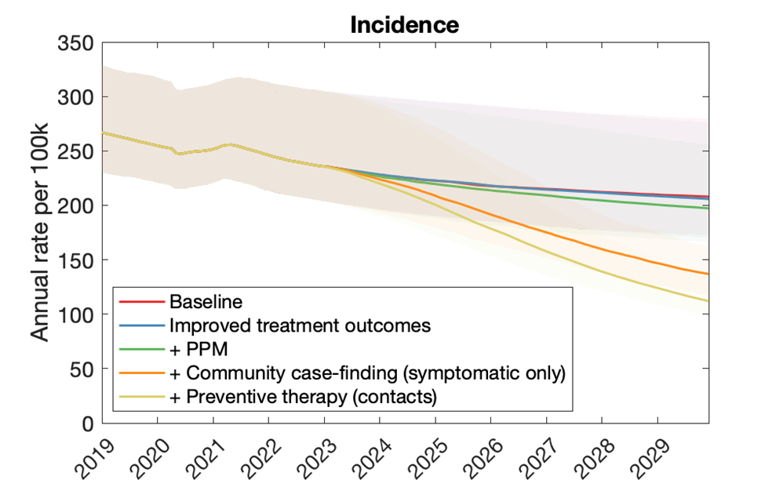
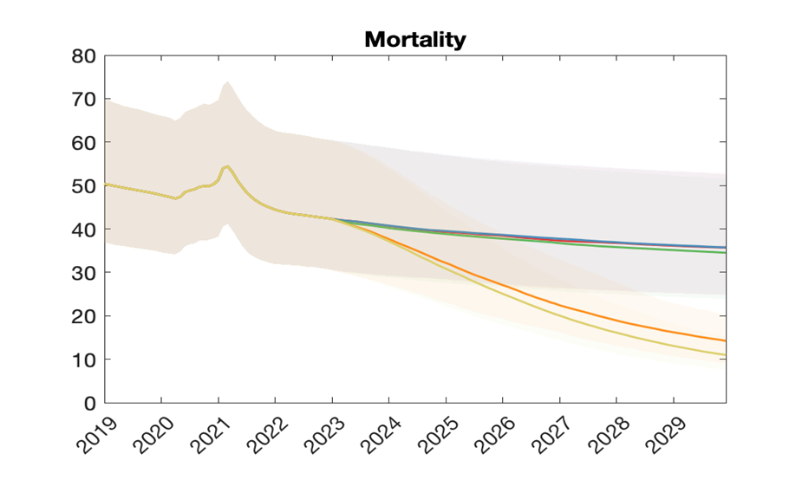
Data driven Initiatives1; NSP development
Modelling interventions

Slide 12
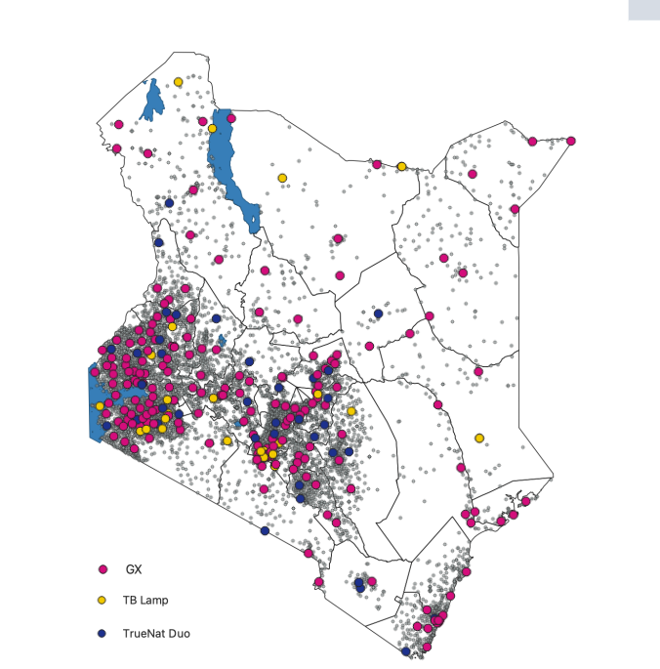
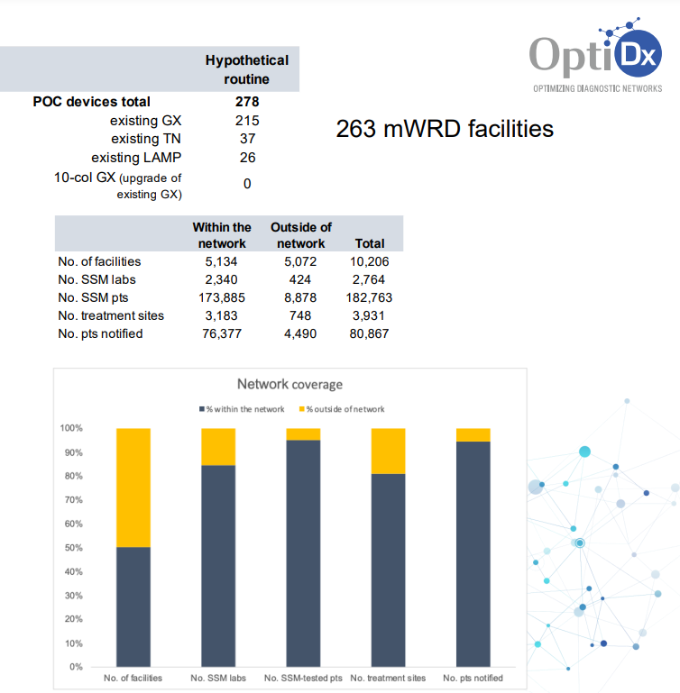
Data driven initiatives2: Diagnostic Network optimization
Add content
Using network optimization software OPTDX
Data sources' reports, ETR reports, TIBULIMs and health facility reports
HIS information; MFL and lab costing data

Slide 13
TB M&E Beyond Numbers: Understanding trends in PBMEF core indicators

Slide 14
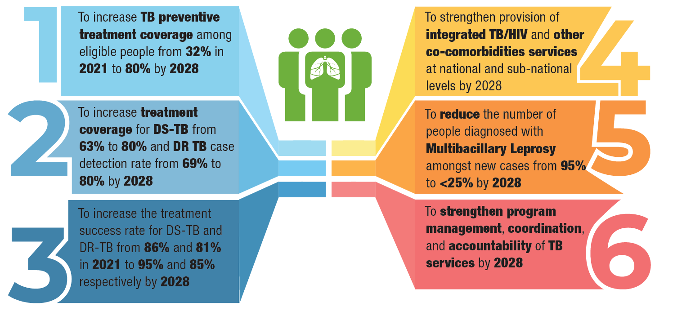
NTP STRATEGIC OBJECTIVES 2023/24-2027/28

Slide 15
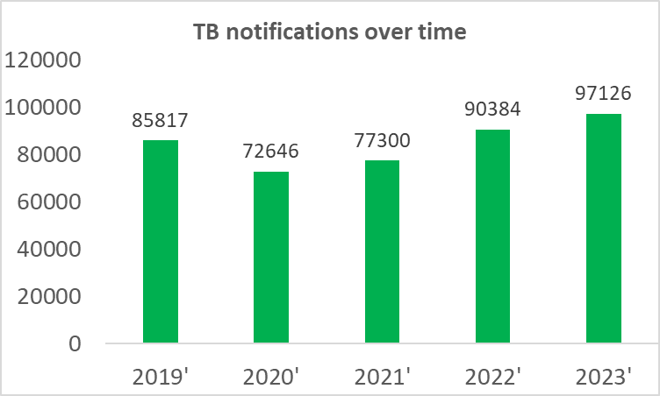
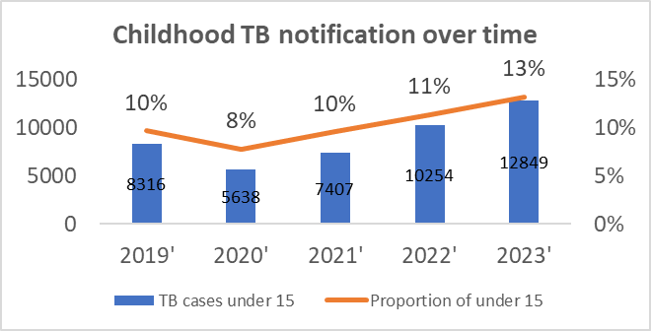
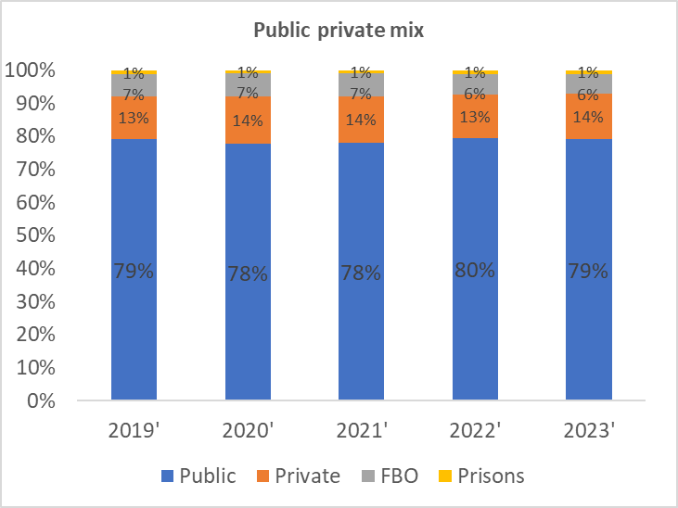
TB Case detection and notification

Slide 16
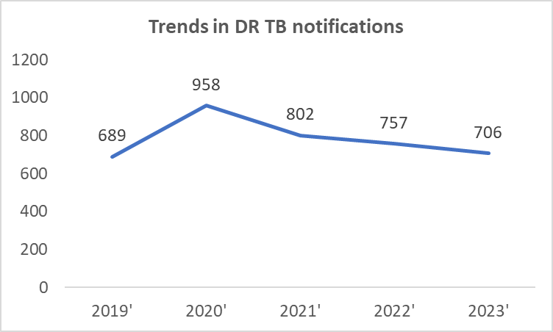
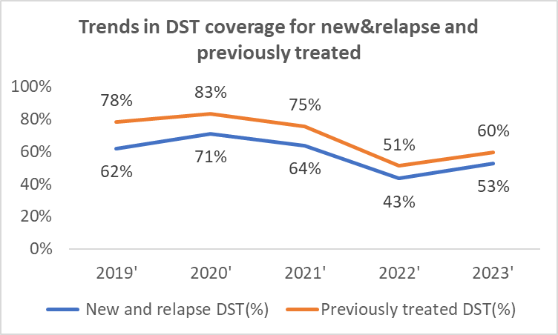
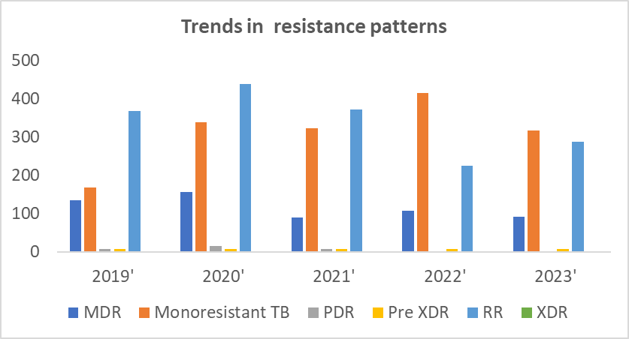
DR TB surveillance & Notifications

Slide 17
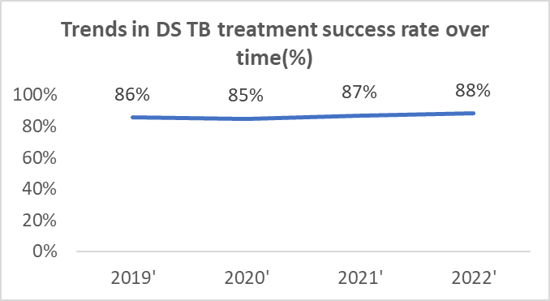
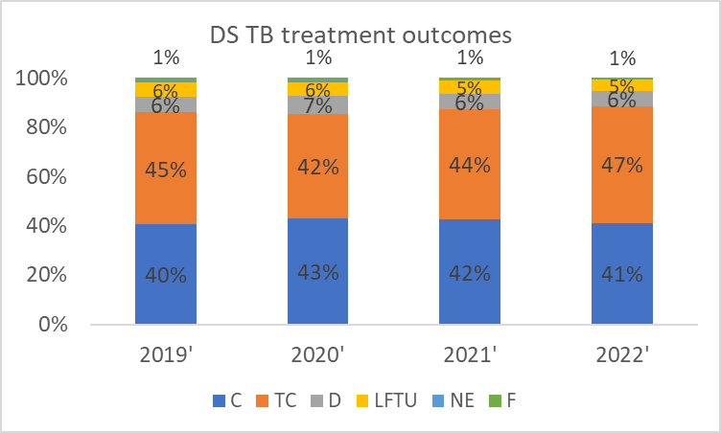
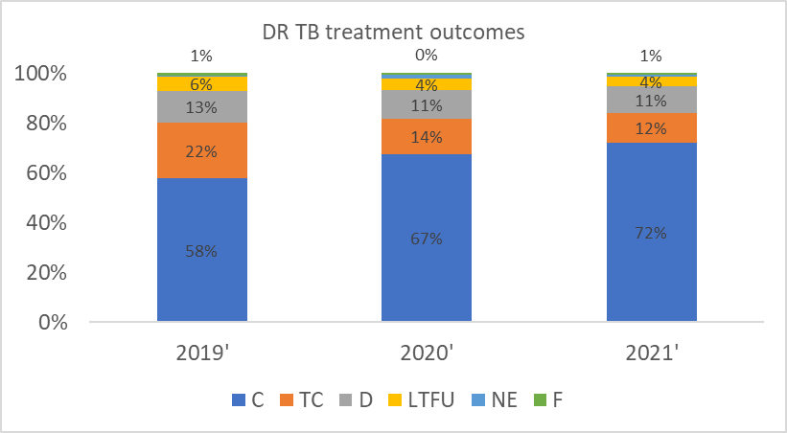
Trends in TB treatment outcomes

Slide 18
THANK YOU
Team Members
Aiban Ronoh-NTP
Ann Masese-USAID KE
Wandia Ikua-USAID KE
Dennis Oira-USAID TB ARC II

